Slide 1
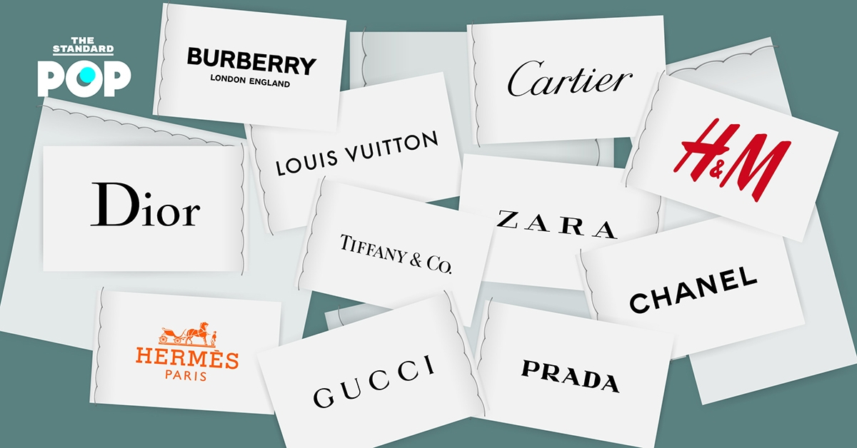
FAD3221 Fashion brand identity design
https://thestandard.co/interbrand-2019/
Taechit Cheuypoung

Slide 2
identity The word Identity (pronounced ad-ta-lak) consists of the words at (ad-ta), which means oneself or oneself, and lak, which means one's own property. The word identity corresponds to the English word that identity (read as i-den-ti-ti) means the sum of the characteristics of something that make it known or remembered. Source: Office of the Royal Society of Thailand: http://legacy.orst.go.th/?knowledges=%E0%B8%AD%E0%B8%B1%E0%B8%95%E0%B8%A5%E0%B8%B1%E0%B8%81%E0%B8%A9%E0%B8%93%E0%B9%8C-%E0%B9%91%E0%B9%96-%E0%B8%A1%E0%B8%B4%E0%B8%96%E0%B8%B8%E0%B8%99%E0%B8%B2%E0%B8%A2%E0%B8%99-%E0%B9%92%E0%B9%95

Slide 3
Human beings have created a culture to meet various needs in order to live in society properly and in accordance with social norms. As a result, members of society are molded to have the attitude, belief, interest, and creativity in the same direction, resulting in unity. is to define one's identity or say who one is, corresponding to the academic term in anthropology that is "identity" (maintaining a good foundation, 2003:73).

Slide 4
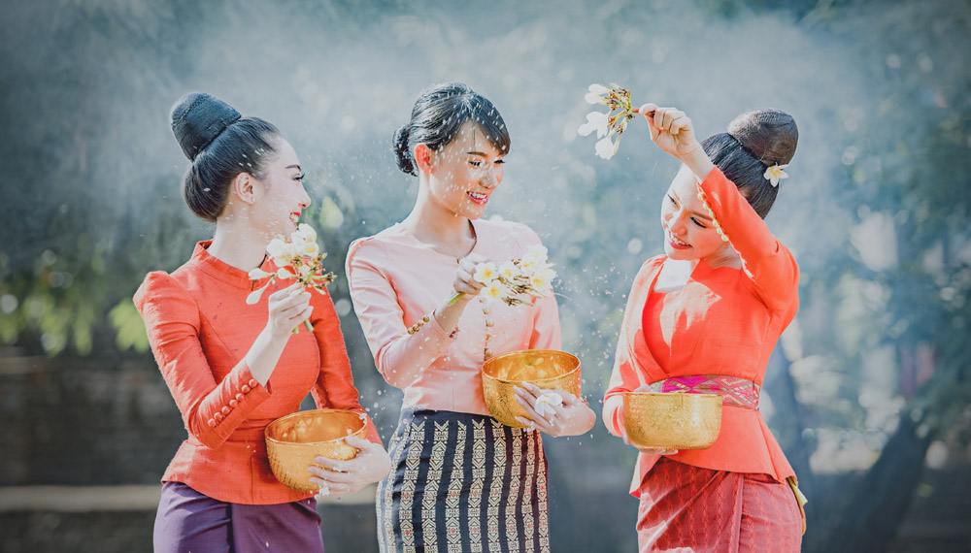
https://lifestyle.campus-star.com/scoop/161619.html

Slide 5
Identity It is a personal consciousness and a collective consciousness in society that arises from self-defined as yourself. Who is it? How are they different from others and what will they use as a sign of expression? What does the word “identity” mean? Part of which is the characteristics of the external self, such as mannerisms, language and expression to other people, and the characteristics of the internal self, such as feelings, thoughts, dispositions, ideologies, beliefs and attachments. Identity is just a word that needs to convey some words to show the identity of a person and is an indicator of the characteristics of the individual, society, community such as race, language. Local culture and religion, etc., which have characteristics that are not common or universal to other societies, that is, characteristics that are different from others (Yurachat Bunsanit. 2003: 65).

Slide 6
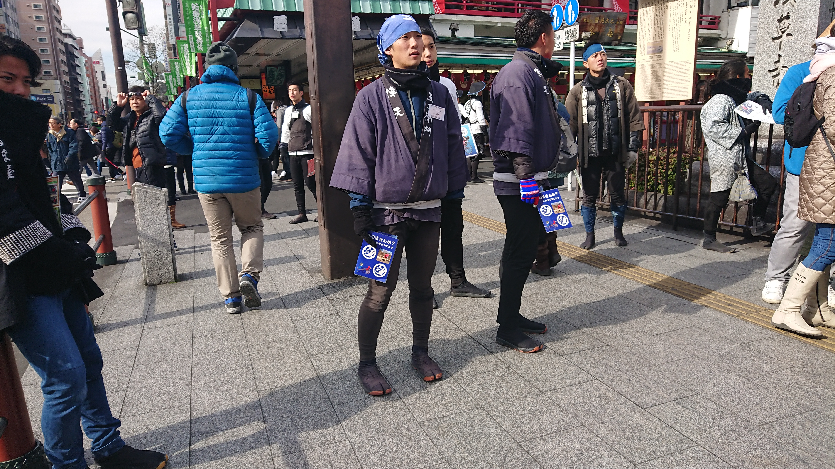

Slide 7
Identity is the feeling of thinking towards oneself that “Who am I?” which will arise from the interaction between ourselves and others. through looking at ourselves and others looking at us and at the same time conceptualizing Identity is said to go hand in hand with power. Definition of meaning or creation of images representing reality (Representation) when identity is related to the concepts mentioned above. seems to have a very different meaning from what is understood by common sense (Apinya Fuangfusakul. 2000:1)

Slide 8
Chaladchai Ramitanon (2002: 34) stated that identity is not a natural occurrence, but a creation of a culture at a certain time and culture is a social construct. ) In addition, culture is not a static or fixed thing. But there is a form of a circuit called Thus, identities are produced, consumed and regulated in those cultures. There are also various meanings created through the symbolic systems of representation that relate to the various identities that we choose to use or create. is our identity. Therefore, the word identity is composed of the word At (ad-ta), which means self or self, and lak, which means property. Identity therefore has a meaning. The sum of the characteristics of something that makes it known or remembered, corresponding to the English word Identity.

Slide 9
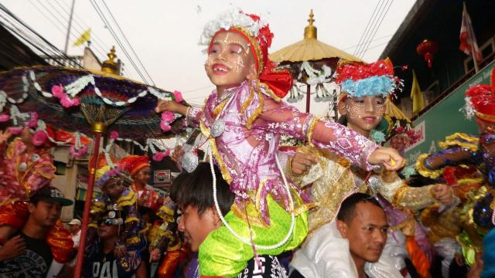
https://www.thairath.co.th/news/local/600458

Slide 10
identity of that person only arises when there is some kind of common sense of self-awareness about one's acceptance of who we are. together with the identity that shows how similar or different it is to other groups Identity arises from both social and individual interactions. Instead, one of the accepted identities will be chosen to be used under the terms of time and space. This identity may be determined either by the individual or by the person. determined by society Identity and society are therefore inseparable.

Slide 11
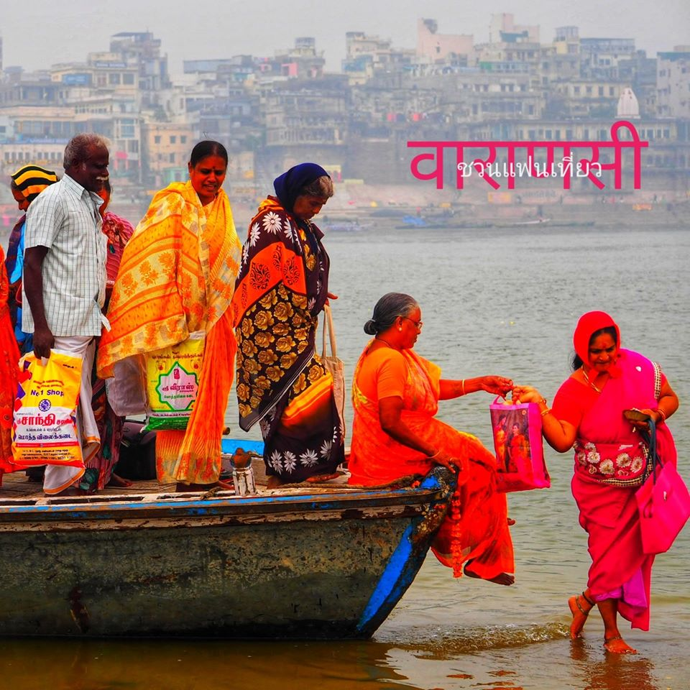

Slide 12
“Identity” has a meaning according to the Royal Institute Dictionary of 1999 that has the same or common characteristics, for example, this community has a unique identity in weaving Jok cloth. It means that all people in this community have the same occupation of weaving Jok. There is only one thing of one thing, for example, the Thai language is the identity of the Thai nation.

Slide 13
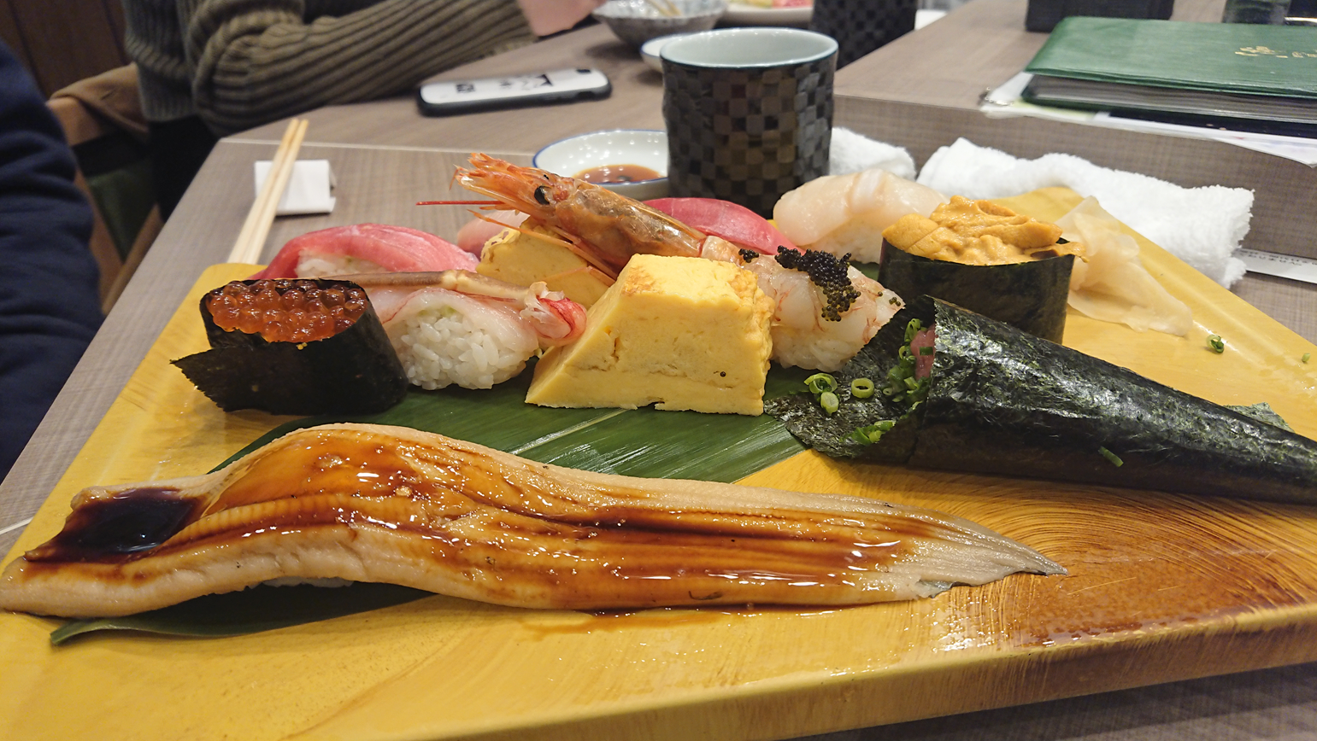

Slide 14
identity not recorded in the dictionary But there are many textbooks that give the meaning of the word "identity" as a unique feature. which is an indicator of the characteristics of a person, society, community or country such as race, language, local culture and religion, etc., which have characteristics that are not common or universal to other societies, or are characteristics that are different from other people's "identity" Derived from the Pali language, atta + laksana, where "atta" means self, one's self, and "characteristics" means one's own property. If looking only at the term "identity", it is more appropriate to be used to refer to the characteristics of something. As for the word "identity", there is the word "eka", which means one, so it seems to mean one characteristic. the same (of many things) or the nature of many things things in common which is the first meaning according to the dictionary ที่มา : http://119.46.166.126/self_all/selfaccess9/m3/529/lesson1/p5.php

Slide 15
https://www.facebook.com/PhasaLaeWankamThai/posts/2850005945023824/

Slide 16
PRADA กับการปฏิรูปวงการแฟชั่นอยู่ตลอดเวลา | Beyond The Runway Ep.5
https://youtu.be/X5Xe9c4YHrM

Slide 17
Identity in your opinion is ? Show ideas and illustrations.

Slide 18
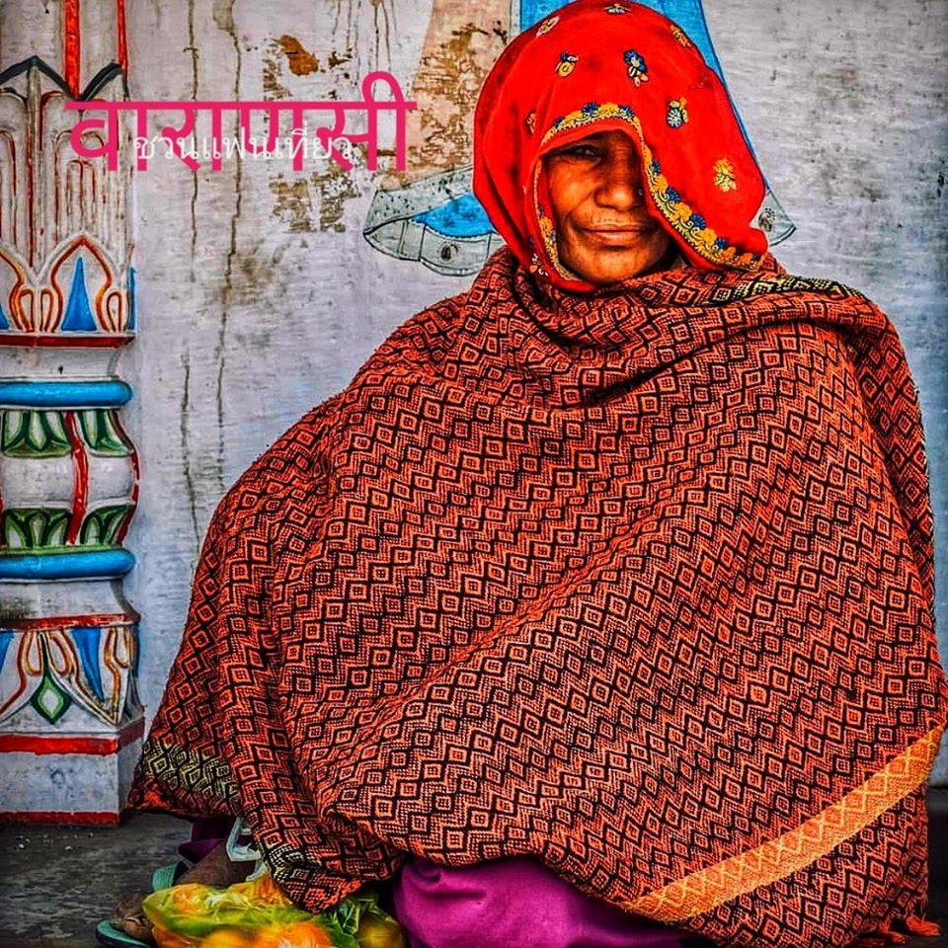
thank you

