Slide 1
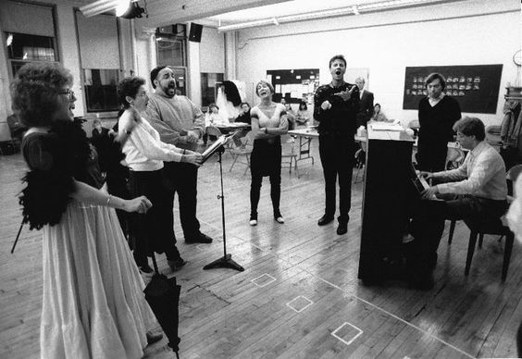
CHAPTER 1
Avenues of Communication

Slide 2
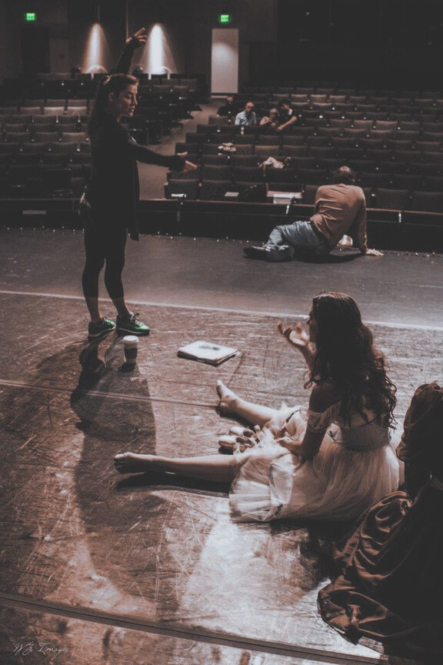
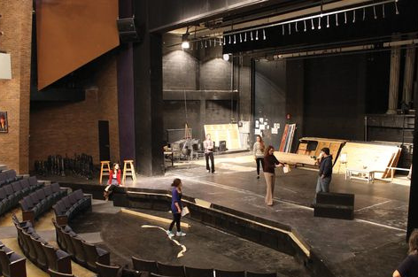
3 Elements of successful communication
TACTFUL
TIMELY
SPECIFIC

Slide 3
Fact-toFact
COMMUNICATION
Word choice, pronunciation, and grammar
Tempo and tone
Body language

Slide 4
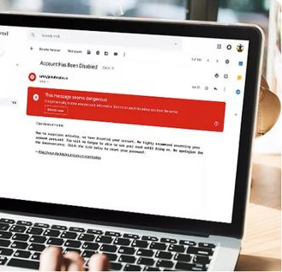
WRITTEN
COMMUNICATION
Email
-Word choice, pronunciation, grammar and spelling
-Formality and professionalism
-Context becomes fluid

Slide 5
WRITTEN
COMMUNICATION
The Callboard
-The originally callboard
-The electronic callboard
The originally callboard

Slide 6
The electronic callboard

Slide 7
The electronic callboard

Slide 8
CHAPTER 2
Principles of Document Design

Slide 9
Informative or Interactive
Justification, Idenification and Reptition

Slide 10
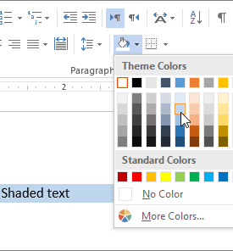
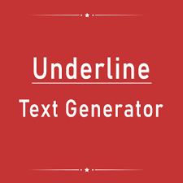
FONT STYLE
Bold
Underline
COLOR AND SHADING

Slide 11
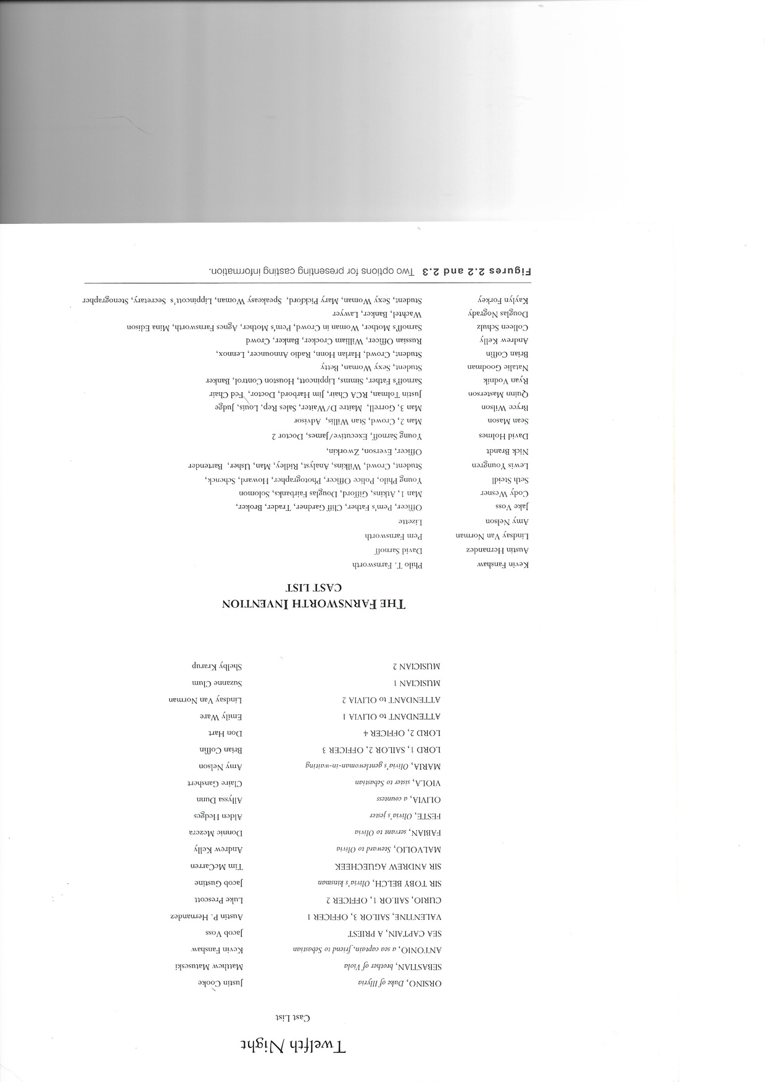
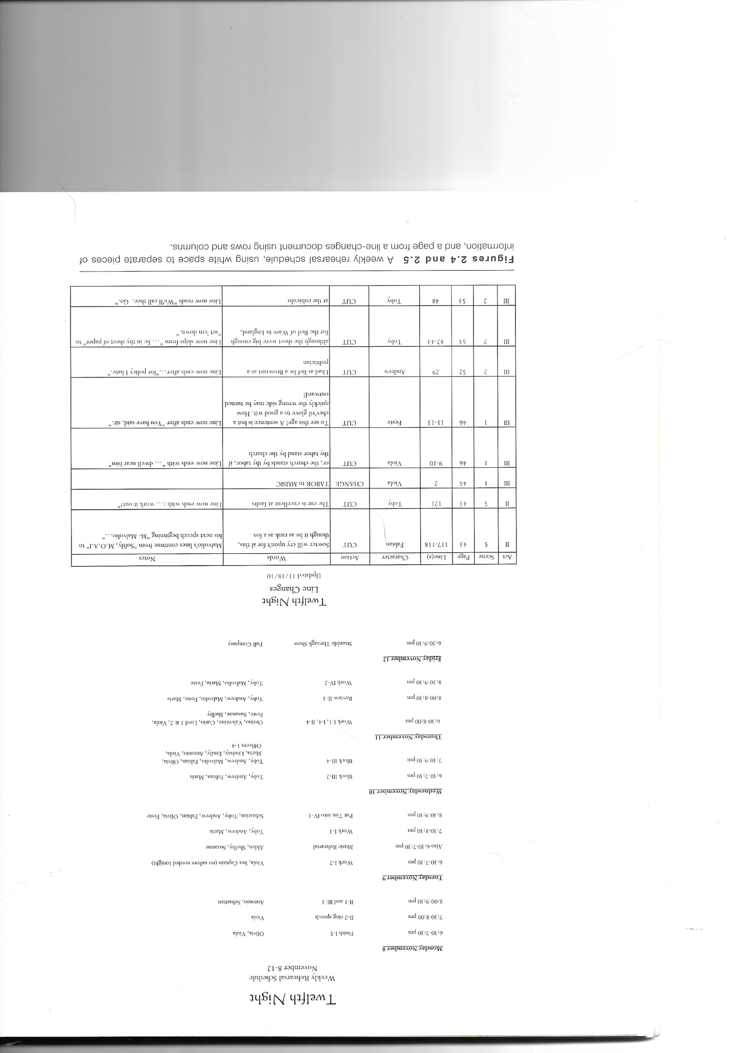

Slide 12
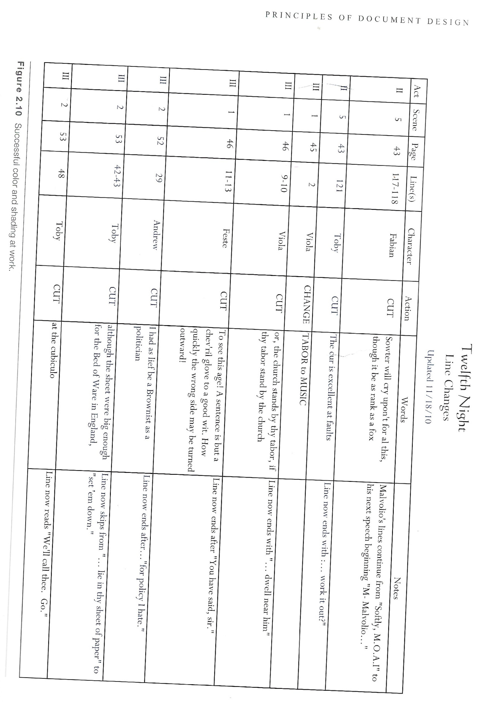

Slide 14
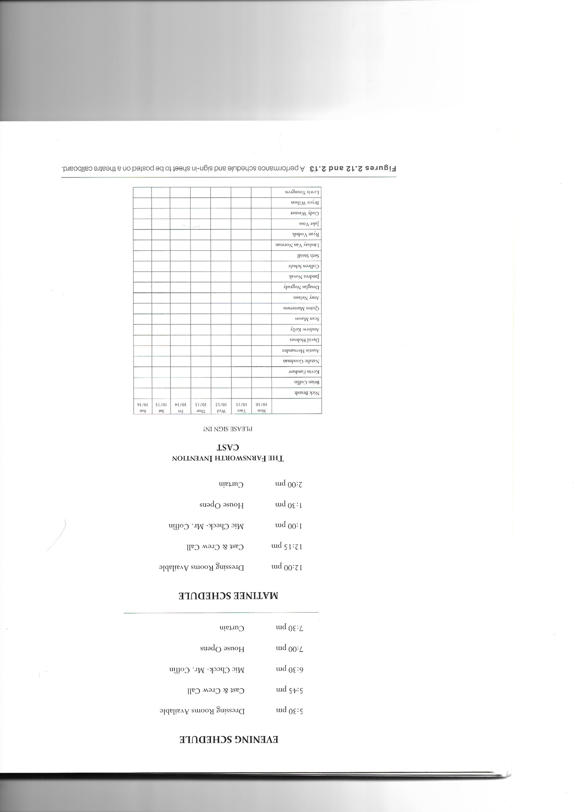

Slide 15
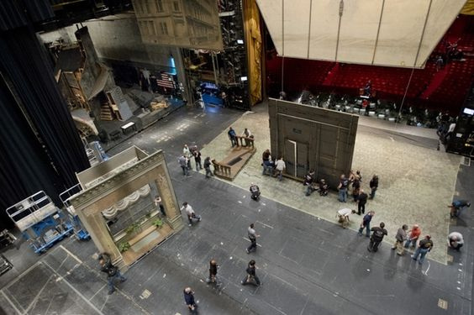
CHAPTER 3
Pre-Production

Slide 16
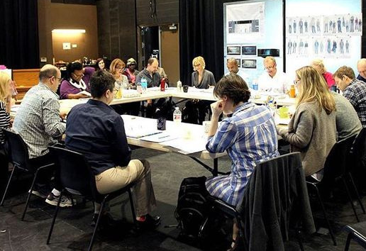
Pre-Production
TASKS
Read and analyze the script
Collect information on the production
Prepare initial lists and breakdowns
Create a prompt book
Meet with the director
Participate in the auditions
Prepare the rehearsal room

Slide 17
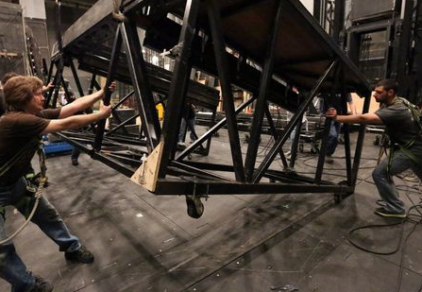
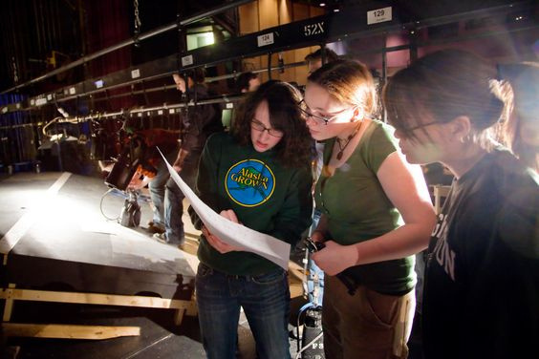
WHO IS THE DIRECTOR?
WHO ARE THE DESIGNERS?
WHERE IS THE SHOW PERFORM?
Given Circumstance

Slide 18
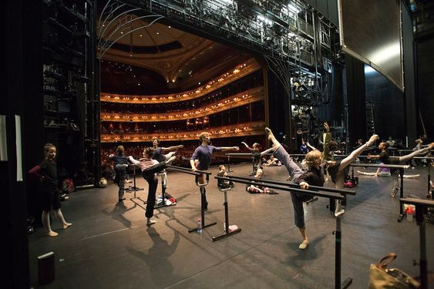
THE CALENDER
The Production Calendar / The Actor Calendar

Slide 19
