Slide 1
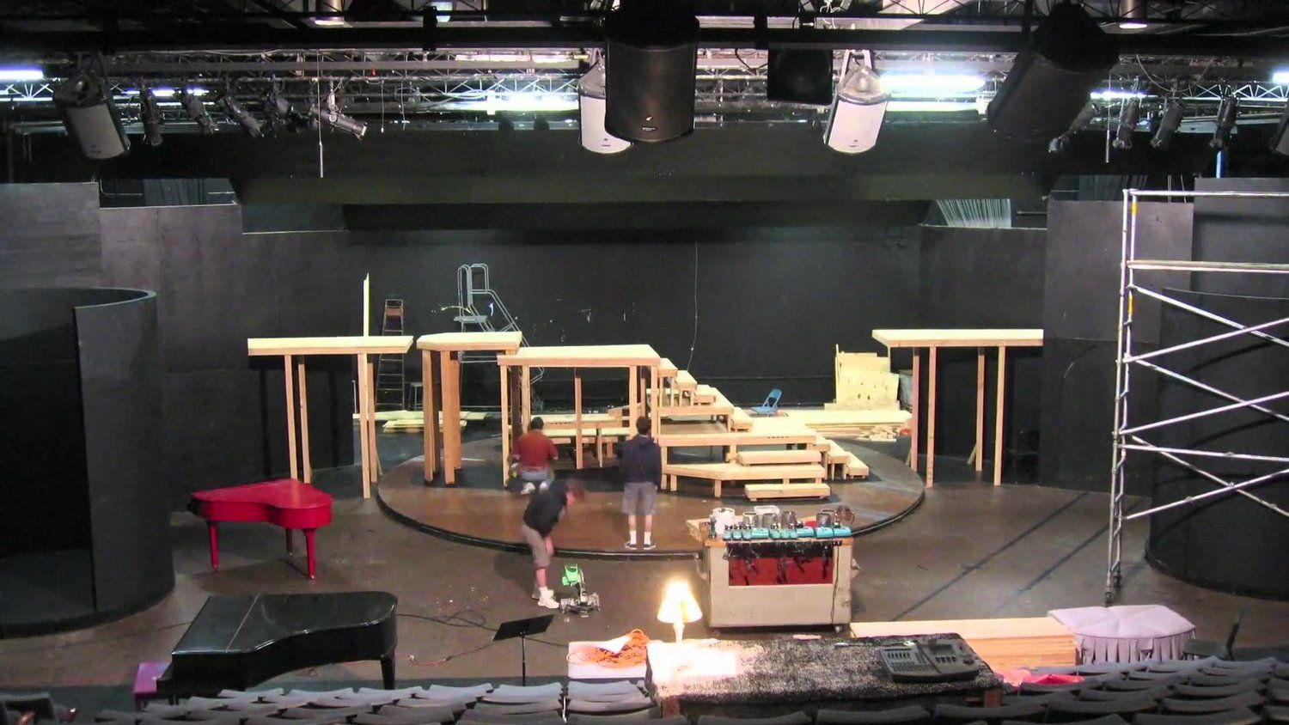
การสร้างฉากเวที

Slide 2
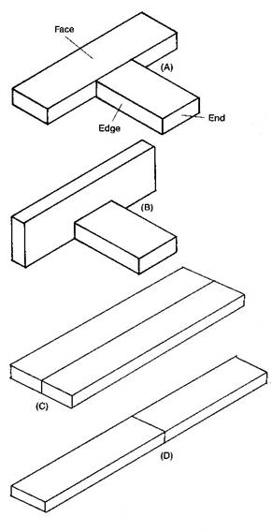
Butt Joint

Slide 3
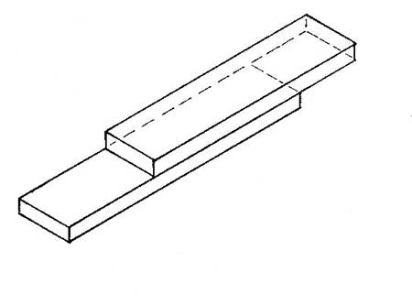
Lap Joint

Slide 4
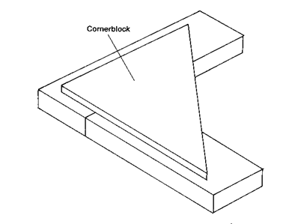
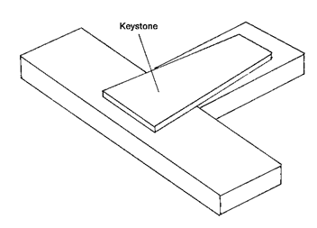
Battened Butt Joint

Slide 5
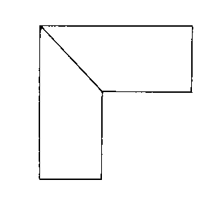
  Miter Joint
“Irregular flat”
A flat that has nonsquare corners!

Slide 6
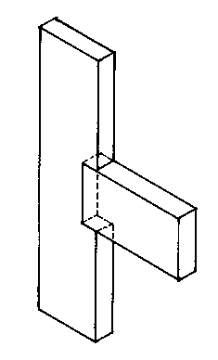
Notched Joint

Slide 7
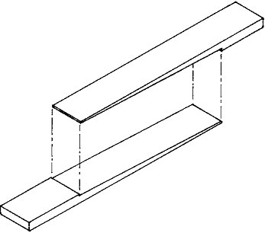
Scarf Joint

Slide 8
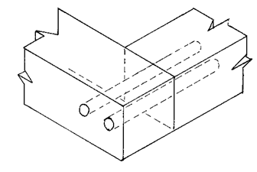
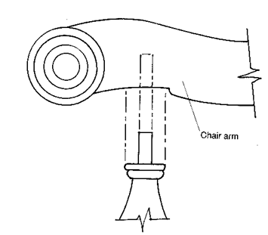
Doweled Joint
open doweled joint
closed doweled joint

Slide 9
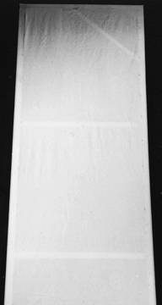
Two-Dimensional Scenery
Two-dimensional scenery can be divided into two basic subgroups
  Hard scenery—Flats
  Soft scenery—Unframed units such as drops and draperies

Slide 10
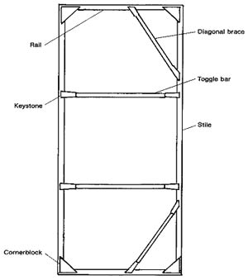
  Flats
Rail—top or bottom framing member
Toggle Bar—an interior horizontal framing member
Stile—a vertical side member

Slide 11
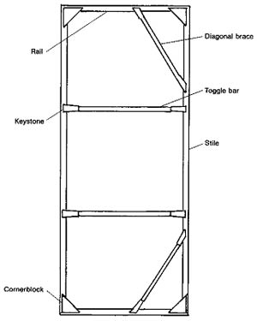
Hard Scenery—Flats
Flats are lightweight frames made of wood or steel tubing
They are normally covered with muslin but can be covered with plywood, Upson board, paper, Masonite, velour, or other fabrics

Slide 12
Rails -These are the top and bottom pieces of lumber that determine the width of the flat
Stiles - these are the side pieces of lumber that determine the height of the flat.
Toggles - these are the pieces of lumber that give support to soft cover flats. They should be placed every 3-4 feet.
Corner braces -these help keep a soft cover flat square.
Fasteners - corner blocks, for stile and rail joints
Half-straps, for fastening the corner braces to the rail and stile
Straps-for fastening the toggles to the stiles.

Slide 13
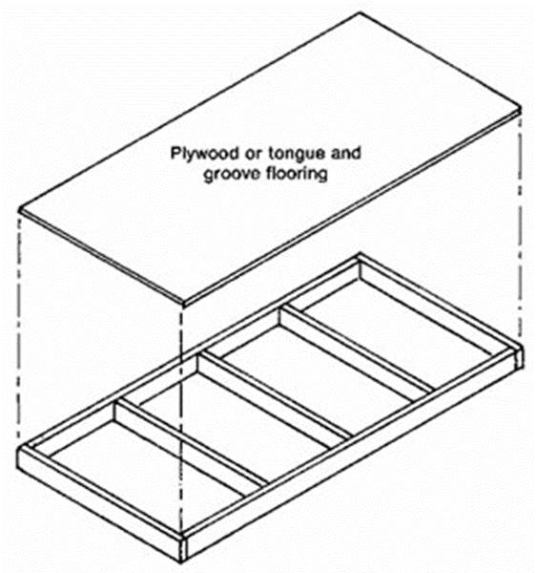
  Stage Platforming
  Platforms are used to create levels
  There are several types of platforms
    Rigid Wooden Platform
    Rigid Steel-Tubing Platform
    Stressed-Skin Platform
    Honeycomb-Paper Lamination
    Parallels

Slide 14
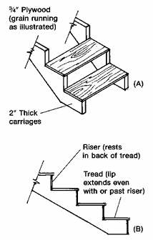
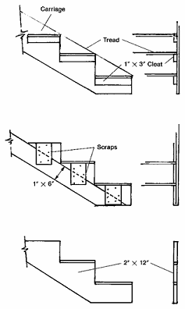
  Stairs

Slide 15
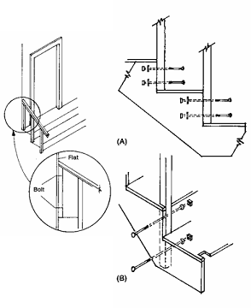
Staircase Railings

Slide 16
Flats
Soft Flats—any flat covered with fabric
Studio Flats—also called Hollywood-style flats, are framed flats that are covered with hard materials, such as plywood. These flats place the framing wood on edge rather than flat for strength
Metal-Framed Flats—uses square metal tubing rather than lumber to frame the flat

Slide 17
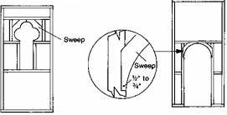
Flats
Door and Window Flats

Slide 18
Flats: Door and Window Flats
There are two types of stage windows and doors
  Dependent—unit is fixed to the flat
  Independent—unit is largely self-contained and can easily be attached to or removed from the flat

Slide 19
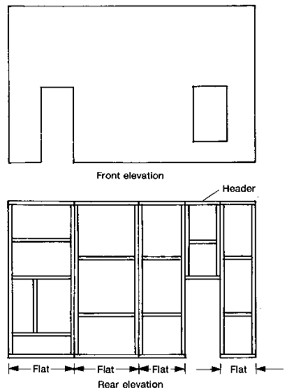
Flats: Joining Flats

Slide 20
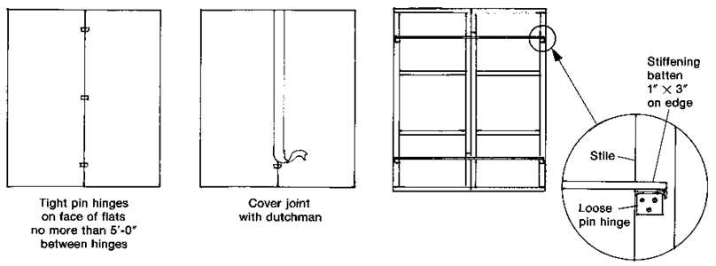
Flats: Rigid Joining
If the multiflat wall does not need to fold, this type of joining is used

Slide 21
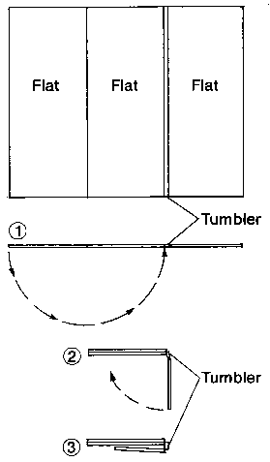
Flats: Flexible Joining

Slide 22
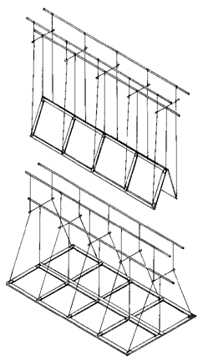
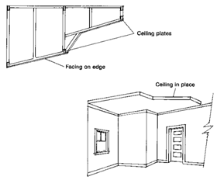
Flats: Ceilings

Slide 23
Soft Scenery: Drops
  Drops are large, flat curtains that have no fullness
  Tie-Supported Drops
  Batten-Clamp Drops
  Opaque Drops
  Translucent Drops
  Scrim Drops
  Cutout Drops

Slide 24
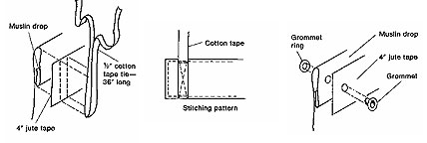
Soft Scenery: Tie-Supported Drops
  The easiest way of hanging a drop is to tie it to the batten

Slide 25
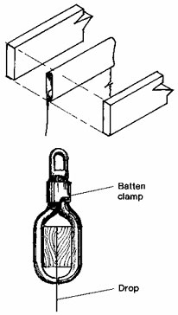
Soft Scenery: Batten-Clamp Drops
  Drops are sometimes attached to a counterweight batten with batten clamps
  The batten clamp facilitates rapid hanging or removal of a drop

Slide 26
  Soft Scenery: Opaque Drops
    Made of heavyweight muslin, these drops are painted with opaque paints and are lit from the front
    The audience cannot see through them

Slide 27
  Soft Scenery: Translucent Drops
  Made of heavyweight muslin, these types of drops are painted with dyes or a combination of dye and opaque paint
  They are lit form both front and back, making the areas that have been dyed translucent

Slide 28
  Soft Scenery: Scrim Drops
    Made from sharktooth scrim or theatrical gauze, scrim drops can become transparent when the scene behind it is lit
    They can be painted with either dyes or thinned paints

Slide 29
  Soft Scenery: Cutout Drops
  These types of drops have sections cut out of the material
  They create a sense of depth and should be painted before being cut to prevent curling

Slide 30
  Soft Scenery: Draperies
    The two types of draperies used in the theatre are stage draperies and curtains
    A more thorough discussion of stage draperies appears in Chapter 4, while curtains are covered in Chapter 11

Slide 31
  Three-Dimensional Scenery
  The term refers to the construction of platforms, stairs, and other similar objects

Slide 32

Rigid Wooden Platform
The easiest and least expensive stage platform to build
The legs are detachable, so its height can be easily varied

Slide 33
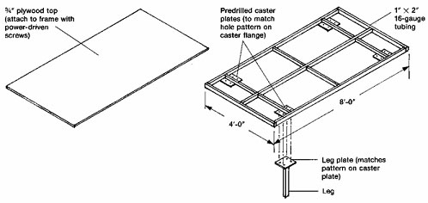
  Rigid Teel-Tubing Platform
  Steel tubing can also be used to fabricate rigid platforms

Slide 34
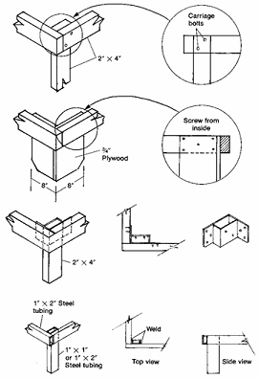
Rigid Platform Legs
Legs for rigid platforms can be fabricated from a variety of materials
All platform legs over 18 inches tall should be braced, regardless of the material of which they are made

Slide 35
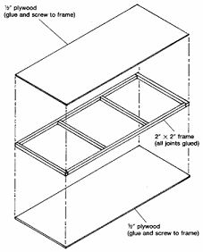
Stressed-Skin Platform
Stressed-skin construction involves securely gluing or screwing plywood “skins” to an internal framework that is nailed and glued
Because the skins can be “laminated” from two sheets of easily warped plywood, stressed-skin construction can be used for making curved platforms
Skin
A plywood covering for the top or bottom of a platform
Laminate: To build up an object from several layers

Slide 36
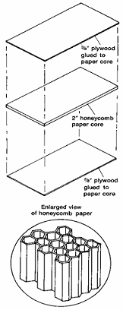
Honeycomb-Paper Lamination
This lamination method is based on the principles used to fabricate the wings of supersonic aircraft
These platforms are made by sandwiching “honeycomb paper” between two sheets of plywood
Honeycomb paper
A manufactured paper product with a hexagonal structure similar to a honeycomb

Slide 37
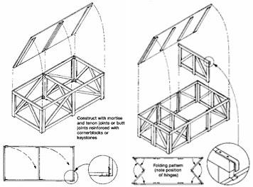
Parallels
Another type of platforming that comes in two varieties. In both, the top is removable and the framework folds for compact storage
Standard parallel: this platform is hinged to fold like a giant parallelogram
Continental parallel: this platform is hinged differently than the standard. It folds into a more compact unit, but its center supports must be removed first

Slide 38
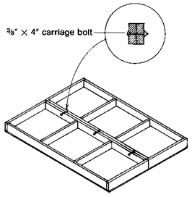
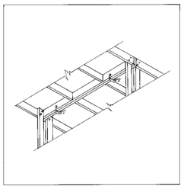
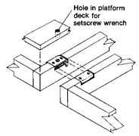
Connecting Platforms
Platforms must be connected to improve the lateral stability of the floor unit
Platforms can be connected in a number of ways
Bolting
Clamping
Casket Locks

Slide 39
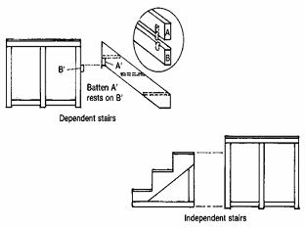
Stairs
Two basic types of stairs are used in scenic construction
  Dependent—units that require support from some other element (such as a platform)
  Independent—units that are self-supporting
While the support method is the primary difference between the two types of stairs, the actual construction of the units is similar

Slide 40
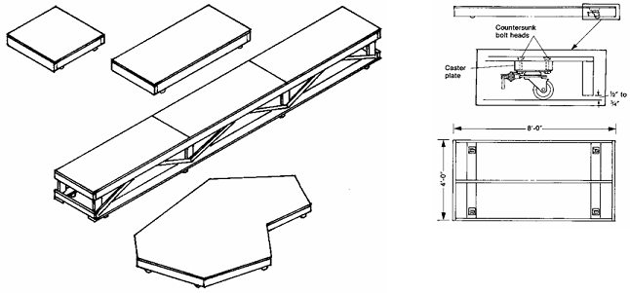
Wagons
Wagons are usually rigid platforms that rest on casters instead of legs

Slide 41
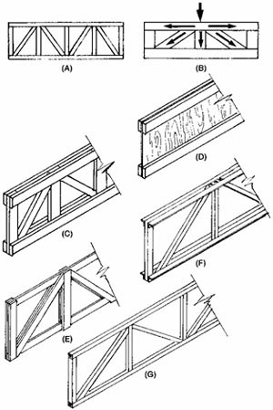
Trusses
Trusses are used when it is necessary to bridge a large span between supporting points
They can be wooden or welded-steel

Slide 42
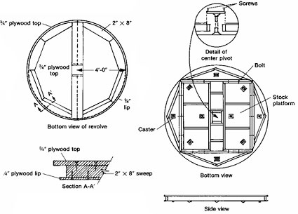
Revolves
Revolves are large, circular platforms that pivot on their central axis
Revolves can be built using any standard platform-construction technique
The rigid platform method seems to work best
Revolves
are also
called
turntables

Slide 43
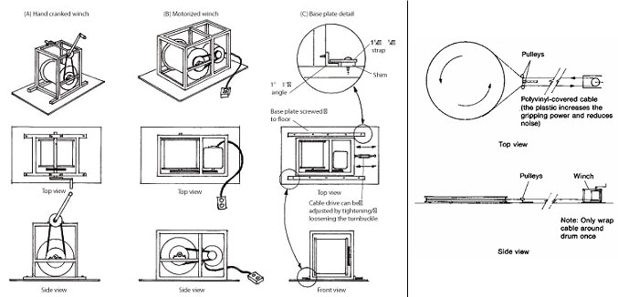
  Winch-Drive Systems

Slide 44
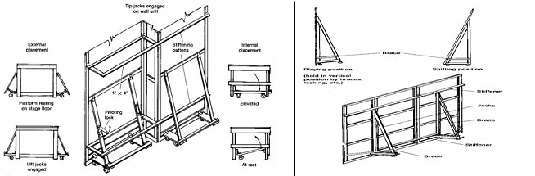
Platform-Anchoring Techniques
Wagons that hold three-dimensional scenery need to be anchored
  Lift Jack
  Tip Jack

Slide 45
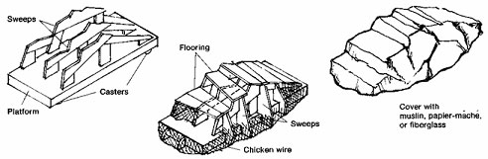
Rocks, Irregular Platforms, and 3-D Trees
All of these items are built in approximately the same manner
These items have surfaces that are not straight, square, or level

Slide 46
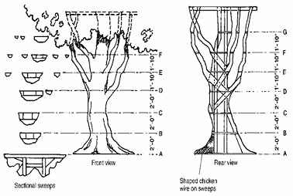
  Rocks, Irregular Platforms, and 3-D Trees
  The irregular quality is achieved with chicken wire and papier-mâché
  Trees can also be constructed using burlap for the bark or foam

