Slide 1
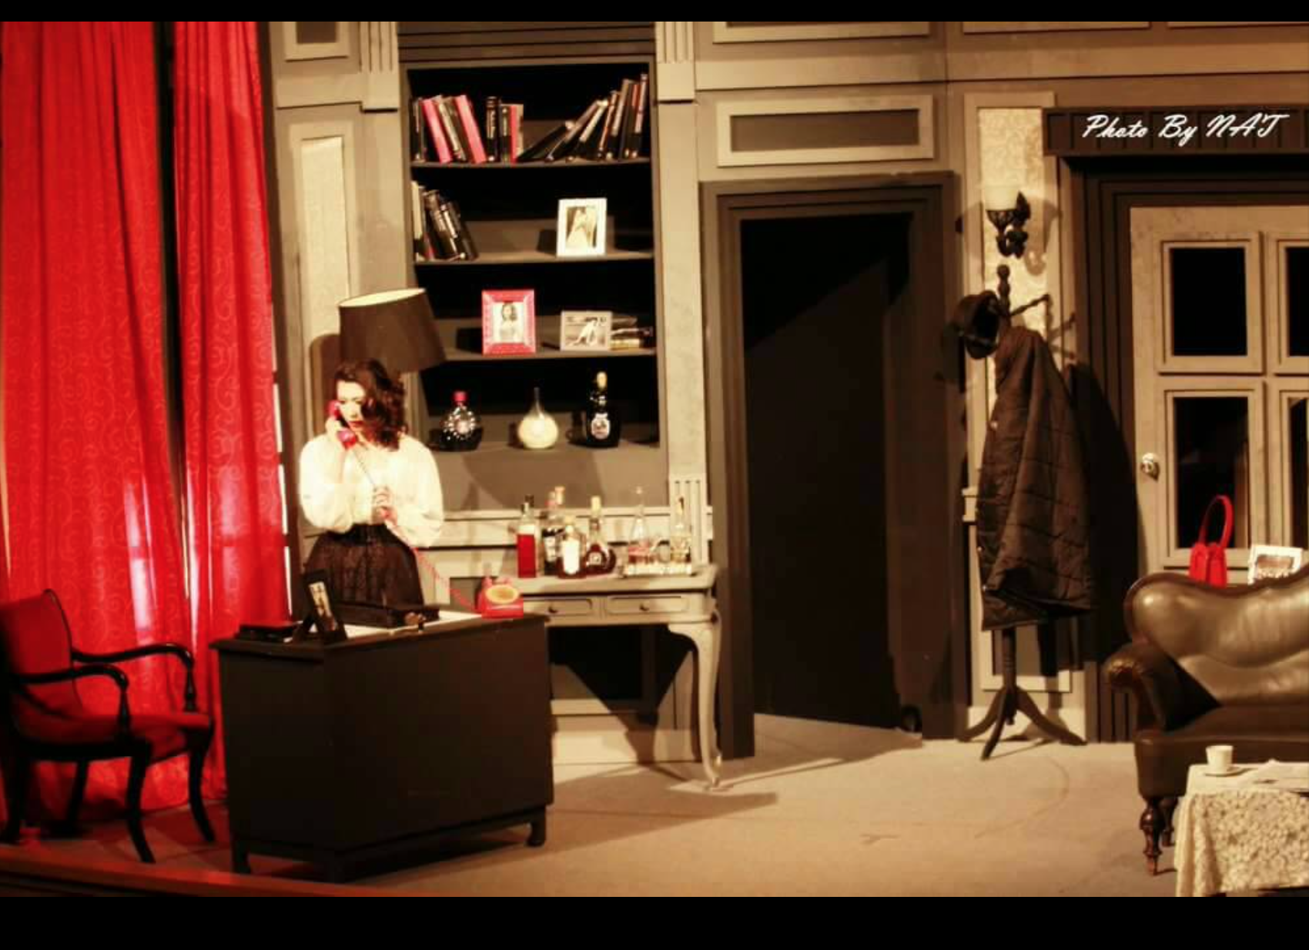
ARTISTIC FOR PERFORMING ARTS
Dr.Pukkaporn Pimsarn
Performing Arts and Creative Entrepreneurship, Faculty of Fine and Applied Arts,
Suan Sunandha Rajabhat University

Slide 4
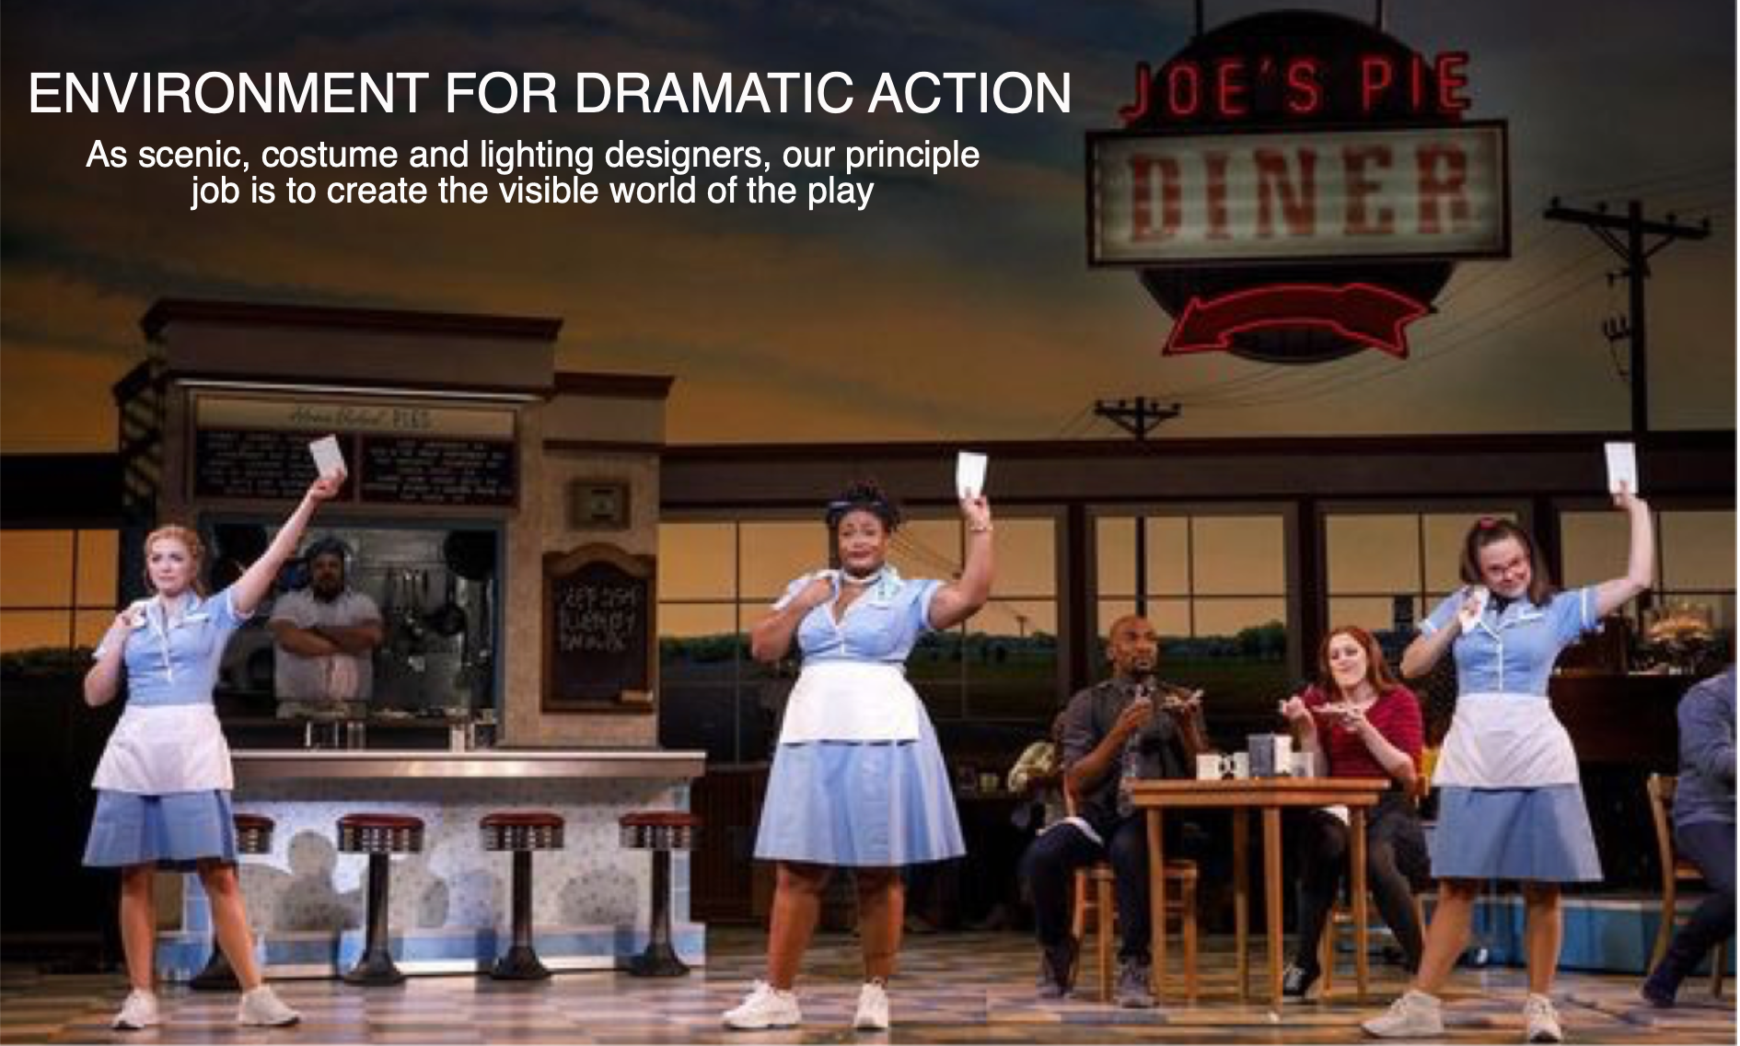

Slide 7
LINE
SHAPE

Slide 8
LINE

Slide 9
SHAPE

Slide 10
COLOR

Slide 11
TEXTURE

Slide 12
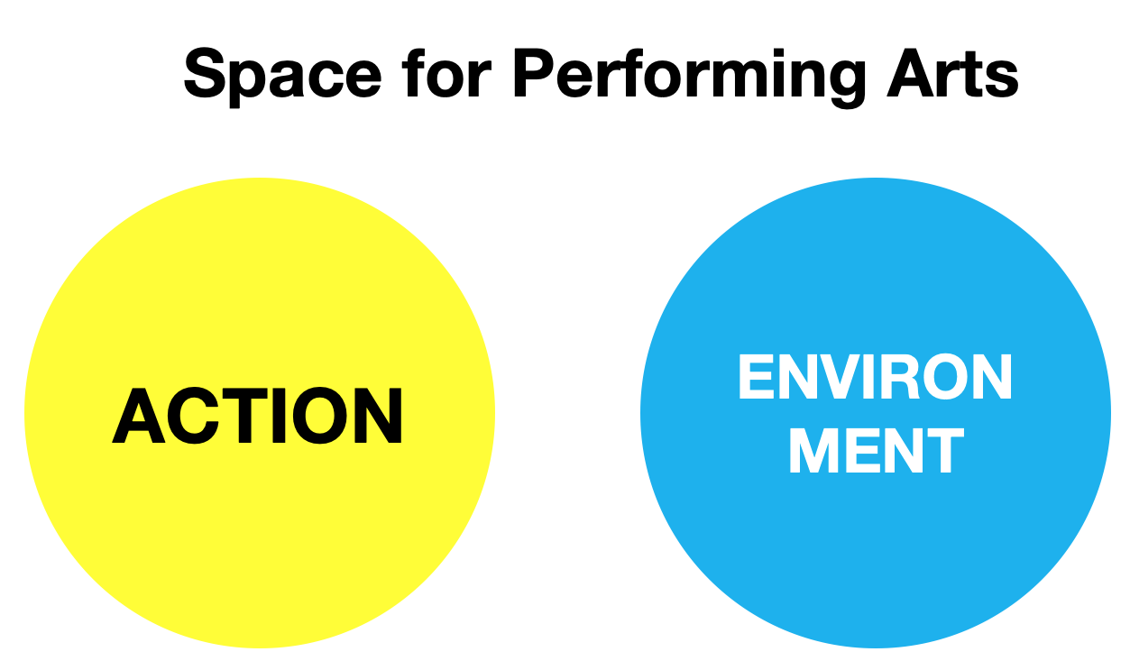

Slide 13
SPACE

Slide 15
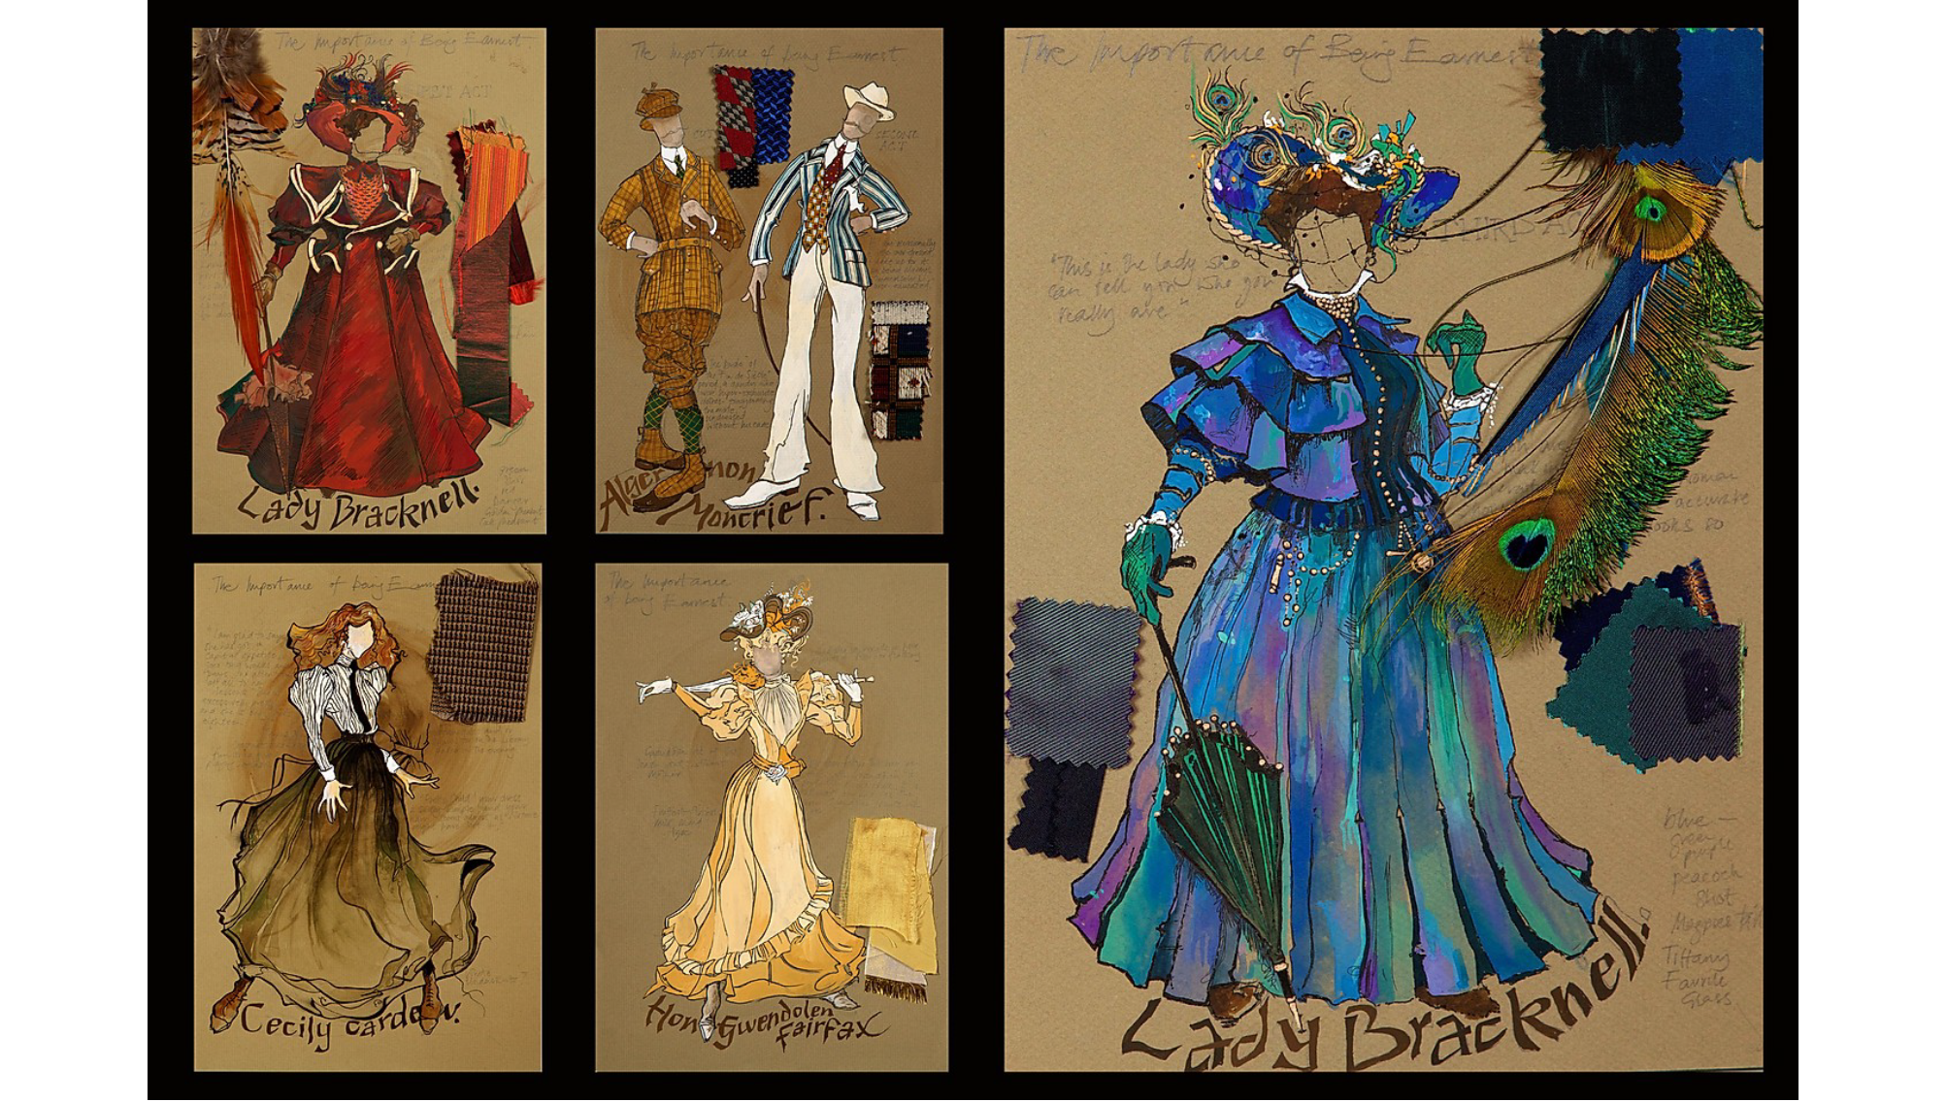

Slide 16
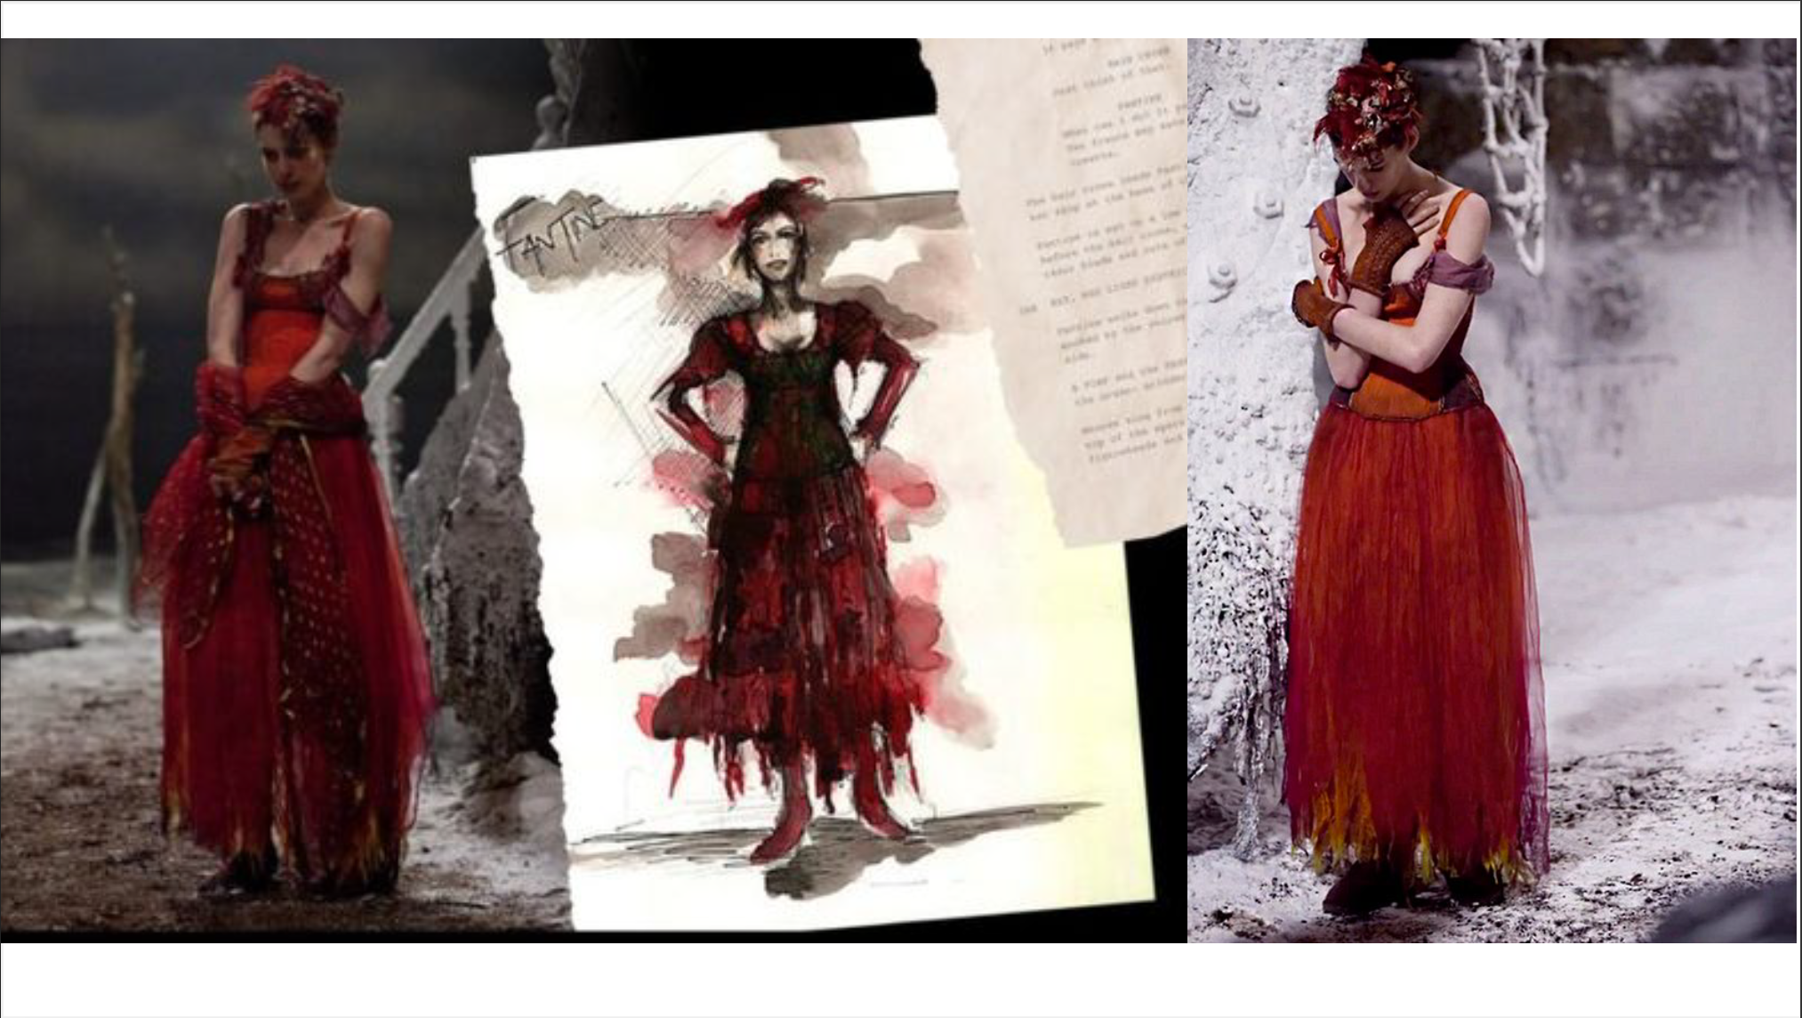

Slide 18
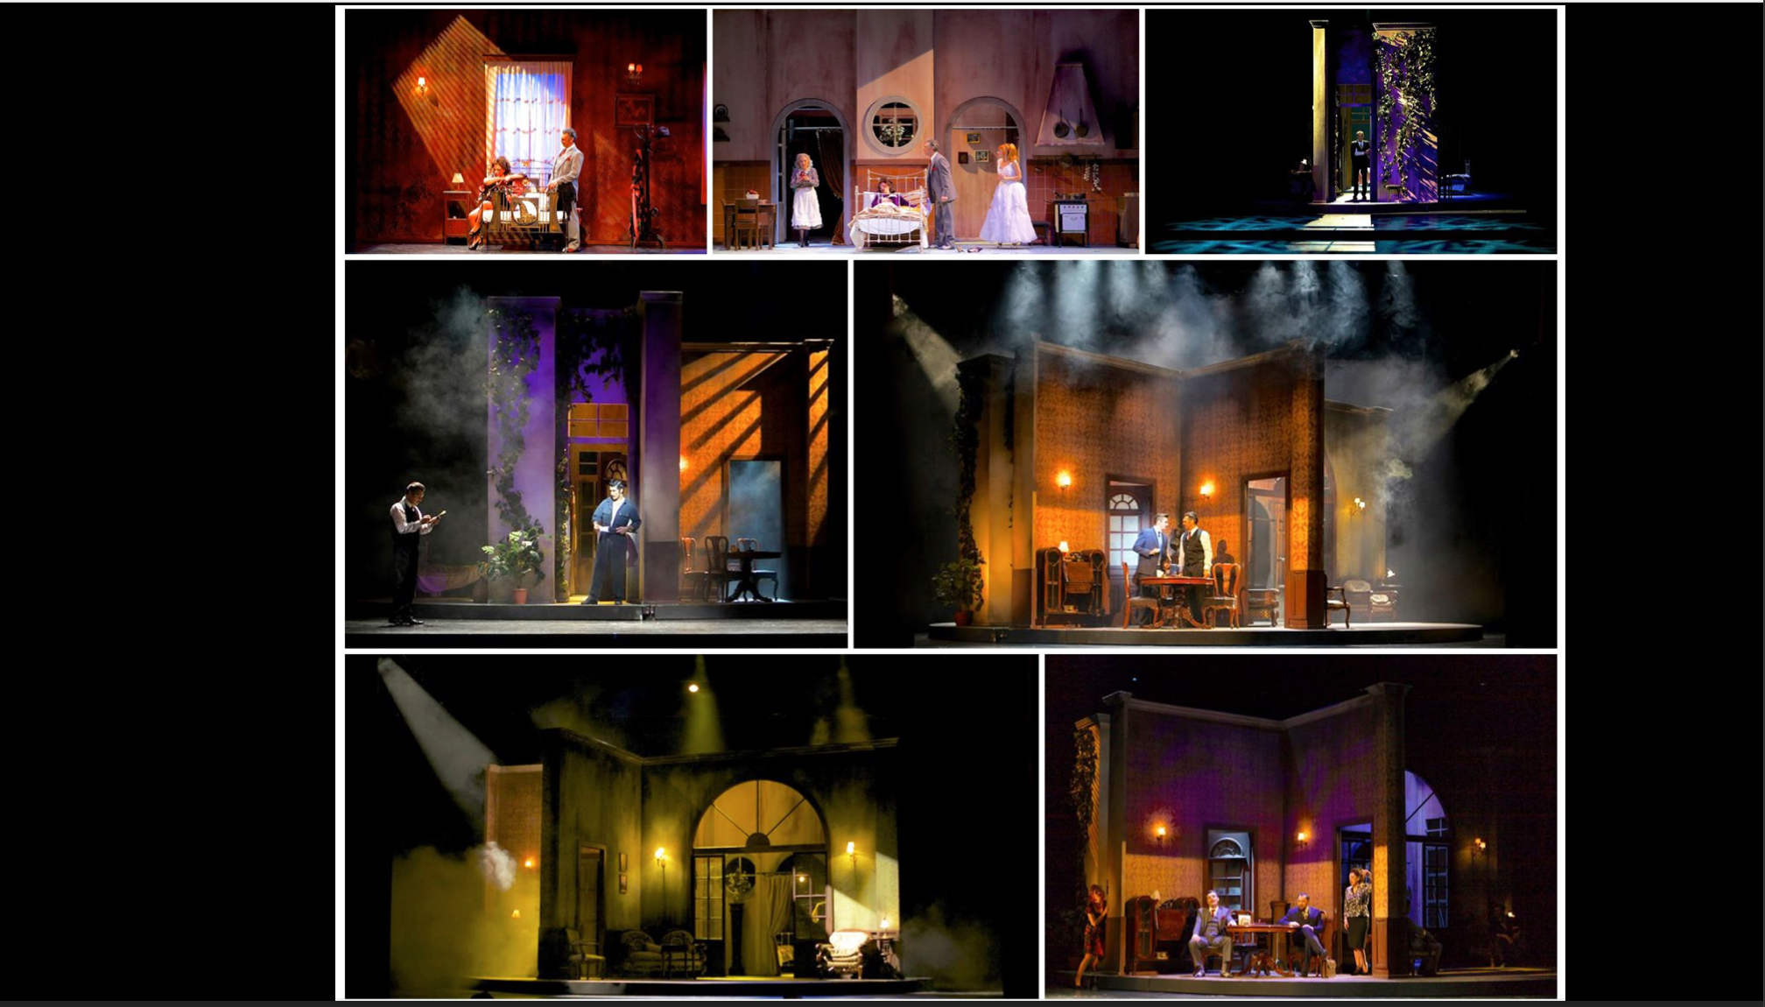

Slide 20
BALANCE

Slide 21
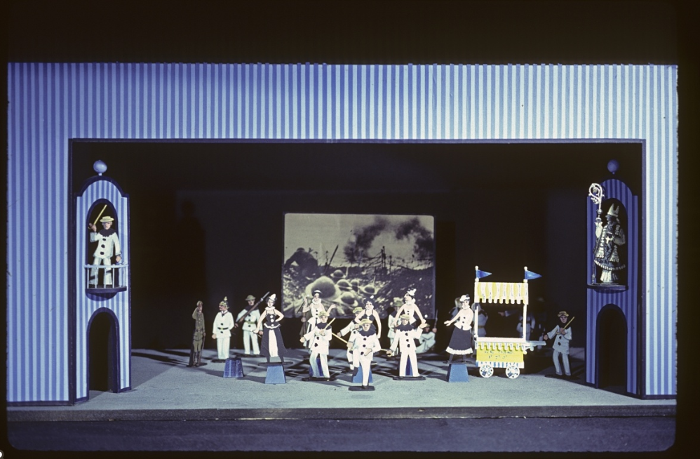
HARMONY

Slide 22
VARIETY

Slide 23
UNITY

Slide 24
WORLD OF PLAY

Slide 26
ARTISTIC FOR PERFORMING ARTS
KEY ART
KEY VISUAL

Slide 28
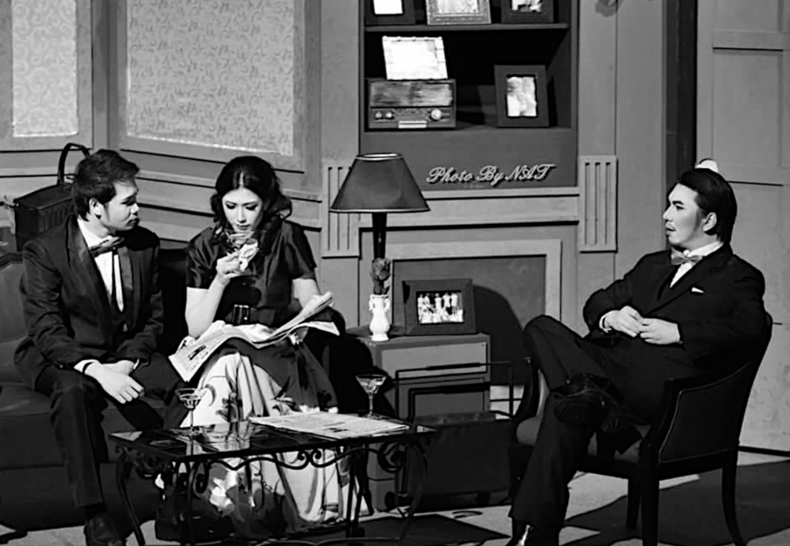
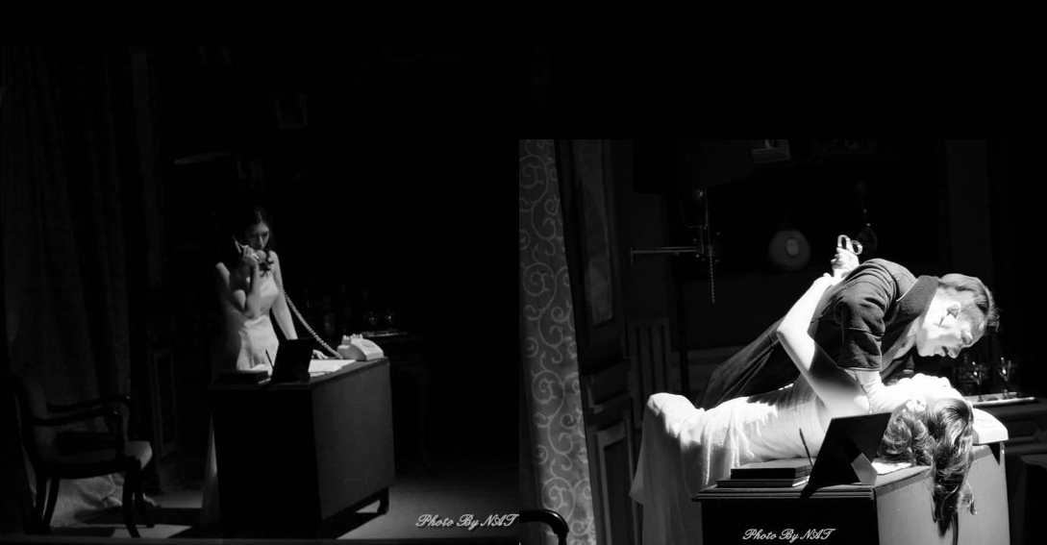

Slide 29
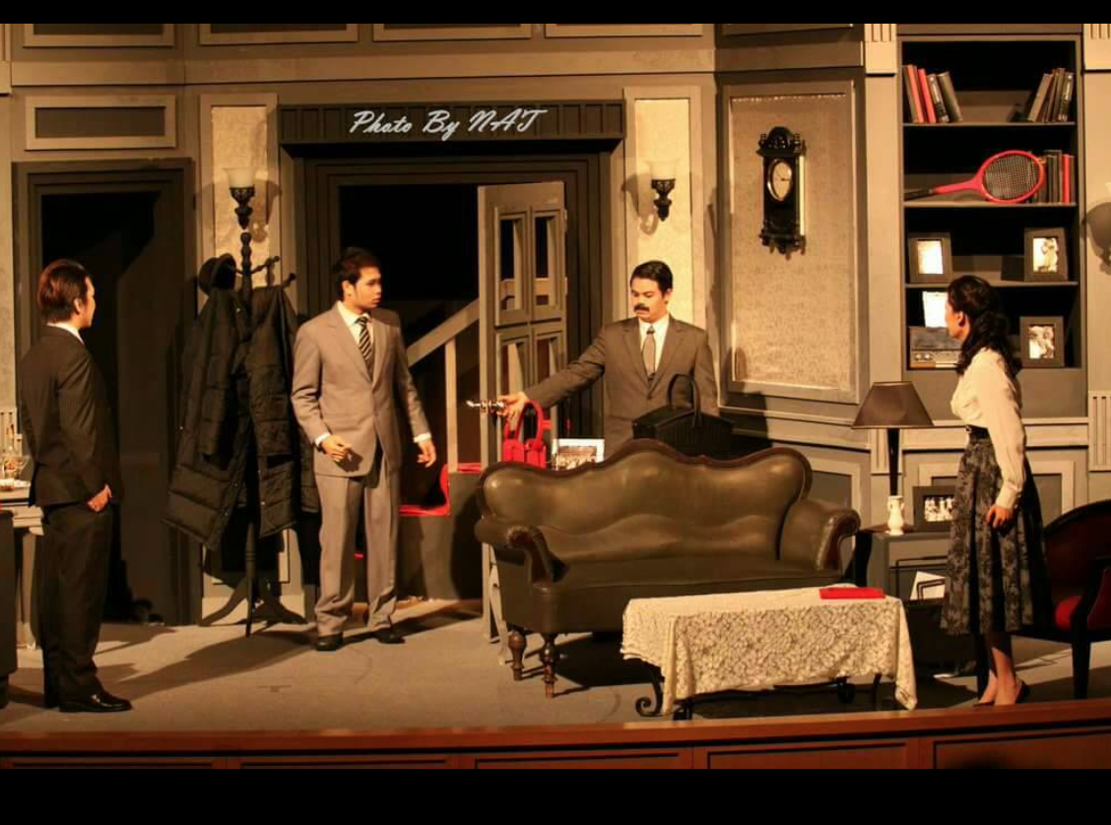
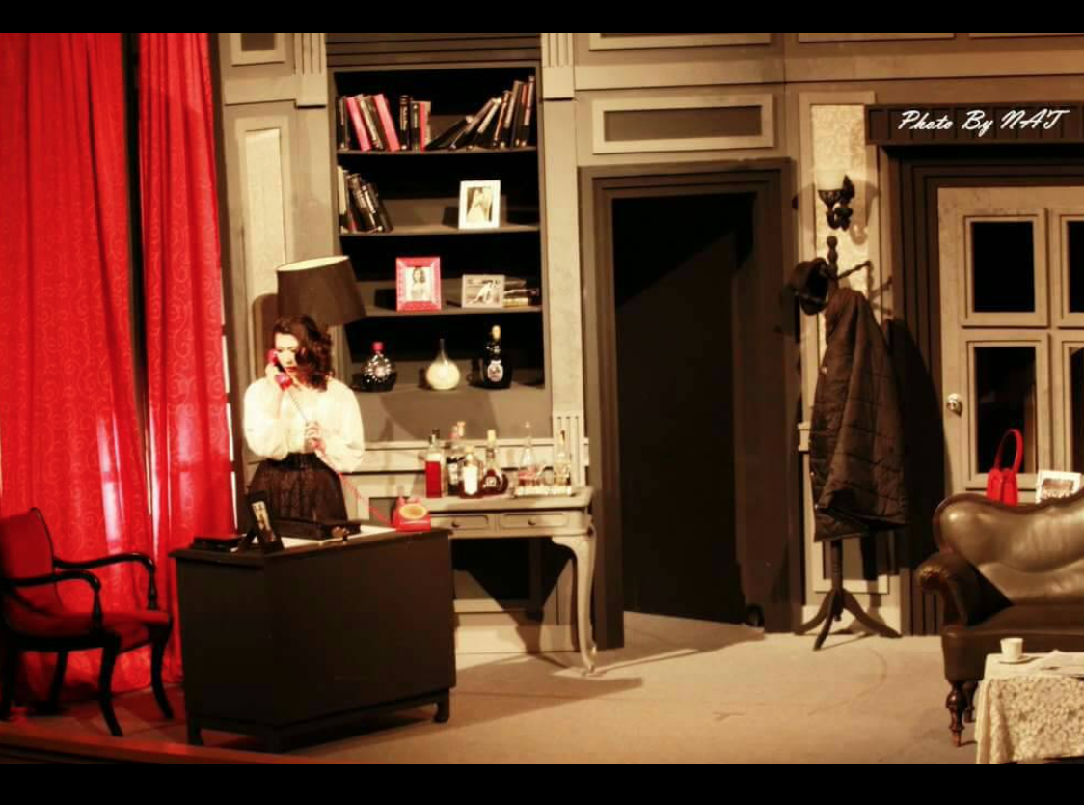

Slide 30
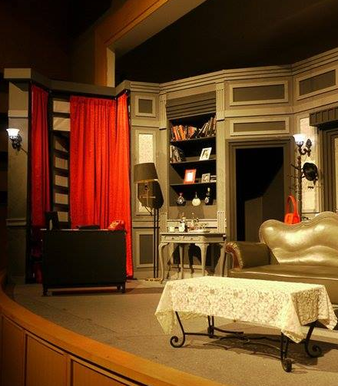
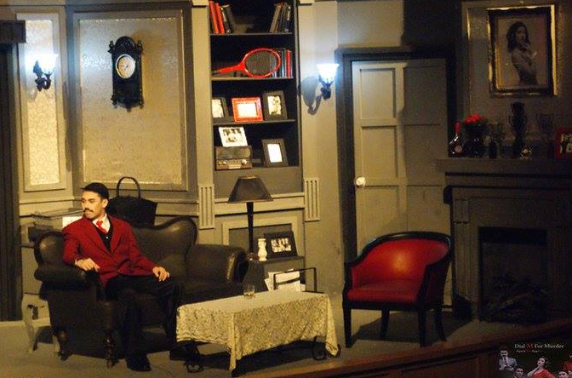

Slide 31
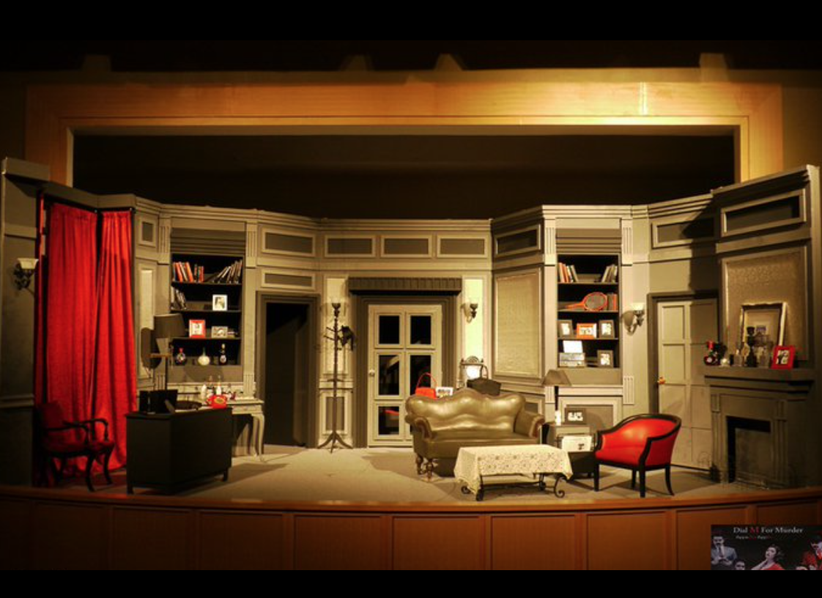

Slide 34
