Slide 1
Thai Music composition MUS3206
Mr. Pramote Thiangtong
music Faculty of Fine and Applied Arts
Suan Sunandha Rajabhat University

Slide 2
component
Thai music genre
stroke rate
melody style
music accent
scale
song proportions
stroke rate
nature of use

Slide 3
Thai music genre
Types of Thai music can be divided according to 2 major characteristics:
1. instrumental music
2. Songs with vocal accompaniment

Slide 4
instrumental music
Refers to a particular piece of music. no accompaniment It is a song that is used to play in occasions, activities, ceremonies, or to perform actions and express various emotions of the performance, such as Na Phat songs, overture songs, narrative songs, solo songs, instrumental songs, cymbal songs, Hang Krueng songs, luk verse songs.

Slide 5
Songs with accompanying choruses
songs that are sung send with music which has a function similar to a song that is played only But with the context of the duty used, there are additional choruses, including
- Rituals such as making a wish, a wedding ceremony, a funeral, Mon crying, etc.
- Accompanied by performances such as Nang Yai, Khon, drama, dance, dance, Li Ke, Rong Ngem, Nora, etc.
- For listening, such as vine songs, two-story songs, liver songs, language songs, Mon songs, various anecdotal songs, etc.

Slide 6
stroke rate
Rhythm determines the slow-speed of the song. In Thai music, there are no fixed rules like western music. It will only be a consensus among the musicians that How fast does each song need to be played? Therefore, it is possible that sometimes the same song performed by different bands will have different speeds.

Slide 7
Thai song rhythm Can be divided as follows
single stroke rate
Two-tiered tempo (twice the number of bars as a single-tiered)
3-tier tempo (the number of rooms is twice that of a 2-tier, or 4 times that of a single-tier)

Slide 8
he cymbal sound that appears in the song at each beat rate can be displayed as follows
Rhythm 3 layers
| - - - - | - - - Ching| - - - - | - - - Chap|
2 layers of rhythm
| - - - Ching| - - - Chap| - - - Ching| - - - Chap|
single stroke
| - Ching - Chap| - Ching - Chap| - Ching - Chap| - Ching - Chap|

Slide 9
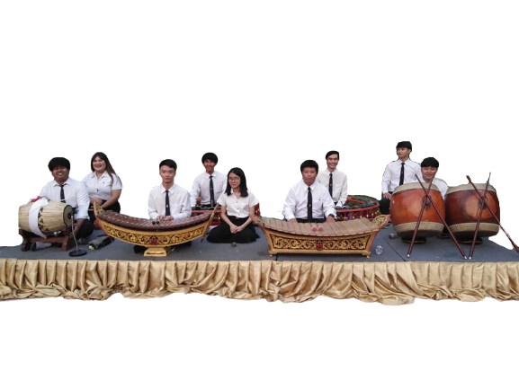
Different types of music
Overture
story song
Naphat song
vine song
liver music
music
drama song
goodbye song
tail music
language songs
out of music
solo song

