Slide 1
PAI3202 Painting 6 Lines and weight value in Painting, IMPRESSIONISM

Slide 2
Impressionism 1872 1892 Post-Impressionism 1880s 1914 Neo-Impressionism 1884 1935

Slide 3
Édouard Manet French Draftsman and Painter

Slide 4
Le Dejeuner sur l'Herbe (1863)

Slide 5
Olympia (1863)

Slide 6
A Bar at the Folies-Bergere (1881-82)

Slide 7
The Execution of Emperor Maximilian (1867-68)

Slide 8
Claude Monet French Painter

Slide 9
Women in the Garden (1866-67)

Slide 10
Westminster Bridge (aka The Thames below Westminster) (1871)

Slide 11
Impression, sunrise (1873)

Slide 12
Boulevard des Capucines (1873)

Slide 13
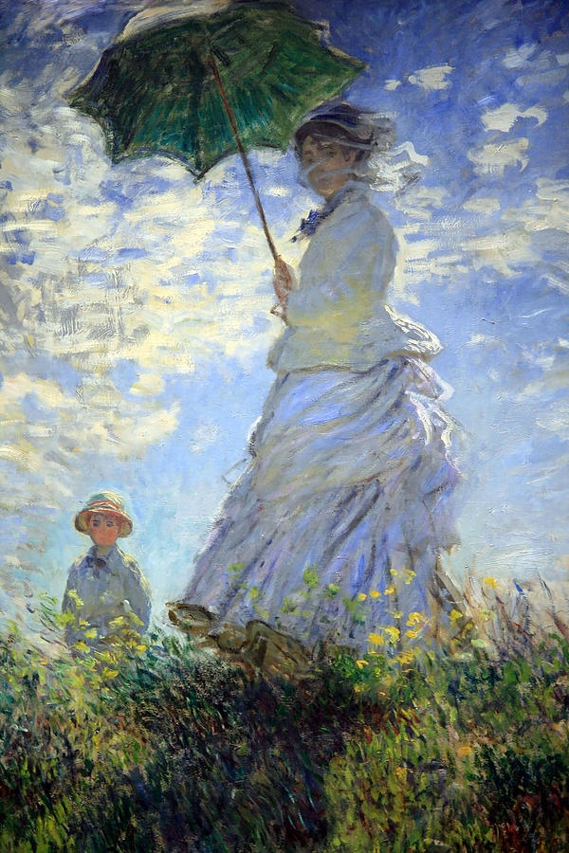
Woman with a Parasol - Madame Monet and Her Son (1875)

Slide 14
Haystacks at Giverny series

Slide 15
Haystacks at Giverny 1884

Slide 18
HAYSTACKS (EFFECT OF SNOW AND SUN) 65 x 92 cm

Slide 25
Haystack. End of the Summer (1890 - 1891), 60.5 × 100.8 cm

Slide 26
Rouen Cathedral series

Slide 27
Rouen Cathedral: The Facade at Sunset (1894)

Slide 28
Rouen Cathedral, Full Sunlight (1894) 73.5 x 107 cm.

Slide 29
Rouen Cathedral, West Façade, Sunlight (1892)

Slide 30
Rouen Cathedral, red, Sunlight 1892

Slide 31
Rouen Cathedral, red, Sunlight 1892-1893

Slide 32
Rouen Cathedral, Harmony in Blue, 1892-1893

Slide 33
Rouen Cathedral in Full Sunlight - Harmony in Blue and Gold (1893)

Slide 34
Rouen Cathedral in Full Sunlight - Harmony in Gold and Blue

Slide 35
Waterloo Bridge (1899) 65 x 100 cm

Slide 36
Waterloo Bridge, Sunlight Effect (1903)

Slide 37
Waterloo Bridge, Hazy Sunshine (1903)

Slide 38
Waterloo Bridge, Sunlight Effect, 1903

Slide 39
Waterloo Bridge

Slide 40
Waterloo Bridge, Sunlight Effect (1903)

Slide 41
Waterloo Bridge at Sunset, Pink Effect (1903)

Slide 42
Waterloo Bridge, London (1903)

Slide 43
Waterloo Bridge, Effect of the Sun

Slide 44
Waterloo Bridge, Grey Weather 1903

Slide 45
Waterloo Bridge, Overcast Weather, 65 x 100 cm

Slide 46
Water Lilies (1915-1926)

Slide 47
Edgar Degas French Painter, Sculptor, and Printmaker

Slide 48
The Bellelli Family (1858–67)

Slide 49
Foyer de la Danse (1872)

Slide 50
A Cotton Office in New Orleans (1873)

Slide 51
Little Dancer of Fourteen Years (1881)

Slide 52
La Toilette (Nude Arranging Her Hair) (1884-86)

Slide 56
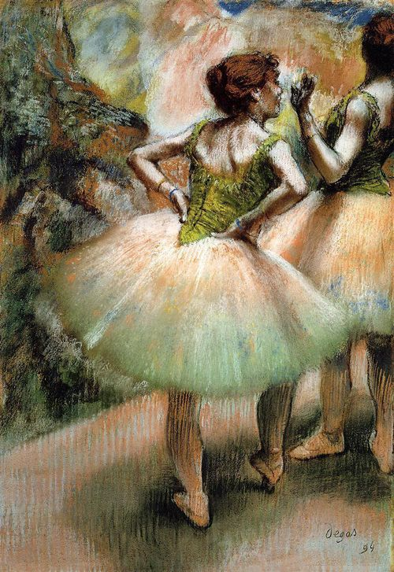
Dancers Pink and Green 1894

Slide 57
Swaying Dancer (Dance in Green)

Slide 58
Pierre-Auguste Renoir French Draftsman and Painter

Slide 59
Diana the Huntress (1867)

Slide 60
La Grenouillère (1869)

Slide 61
Dance at the Moulin de la Galette (1876)

Slide 62
Luncheon of the Boating Party (1881)

Slide 63
The Skiff (La Yole), (1875)

Slide 64
Vue de la poste à Cagnes, 21.2 x 38.1 cm

Slide 65
Nude in the Sunlight. (1875-1876)

Slide 66
The Spring 1895

Slide 69
The Umbrellas (1881)

Slide 70
The Large Bathers (1884-87)

Slide 71
Gabrielle Renard and Infant Son Jean (1895-96)

Slide 72
Portrait of Ambroise Vollard (1908)

Slide 73
Camille Pissarro Danish-French Painter and Printmaker

Slide 74
Jardin de Kew, Londres, près d'un étang

Slide 75
Entrée du village de Voisins, (1872)

Slide 76
the road to Versailles in various seasons (1869)

Slide 77
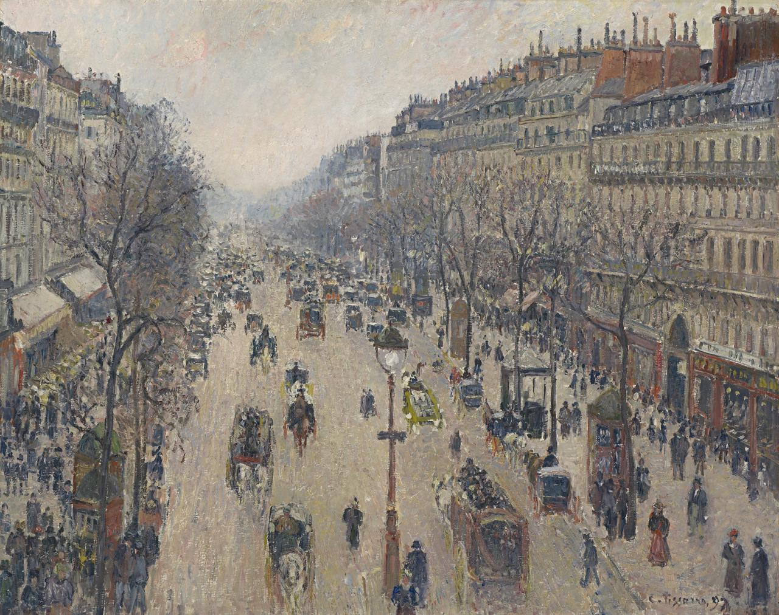
Boulevard Montmartre Morning, Grey Weather (1897)

Slide 78
The Treasury and the Academy, Gray Weather

Slide 80
Postkutsche von Louveciennes (1870)

Slide 81
Automne, Peupliers, Eragny (Autumn, Poplars, Eragny)

Slide 82
Le Ru de Montbuisson, Louveciennes, 46 x 55.5 cm, (1869)

Slide 83
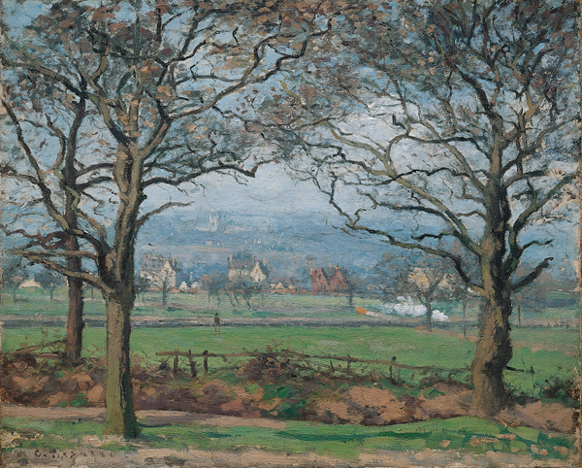
Near Sydenham Hill, (1871)

Slide 84
El bosque de Marly, (1871)

Slide 86
Orchard with Flowering Trees, Spring, PonAtoise, 65.5 x 81 cm. (1877)

Slide 88
John Singer Sargent American Painter

