Slide 1
PAI1201 Painting 2 2 / 2565 Asst.Prof.Dr. Pisit Puntien

Slide 2
Introduction
Guidelines for the creation of subject works PAI1201 Painting 2
- Guidelines for painting with acrylic paints
-Principles of using materials and equipment
- creative approach from basic to advanced tactics
-Works of students in painting major Faculty of Fine and Applied Arts Suan Sunandha Rajabhat University

Slide 3
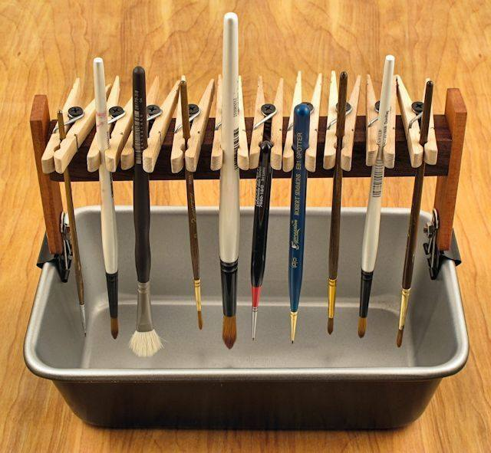
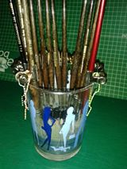
Principles of use of materials and equipment

Slide 4
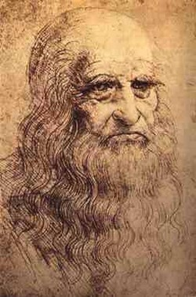
Renaissance
Leonardo da Vinci
1452 – 1519

Slide 5
Mona Lisa Oil on poplar panel 77 x 53 cm.

Slide 7
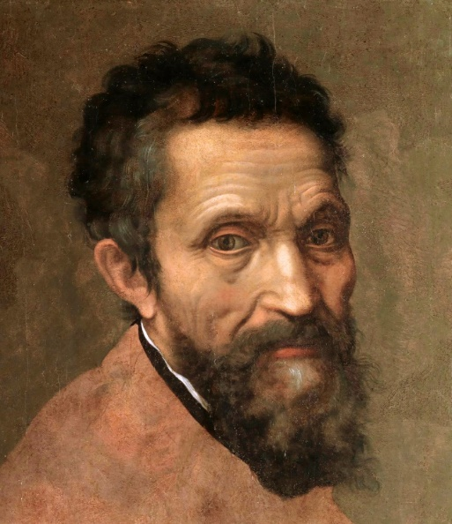
Renaissance
Michelangelo di Lodovico Buonarroti
1475 -1564

Slide 8
FRESCO PAINTING Last Judgement 1536-41 (fresco), Sistine Chapel

Slide 9
The Last Judgement

Slide 11
The Creation of Adam

Slide 12
Expulsion from Paradise

Slide 13
David

Slide 15
Renaissance
Raffaello Sanzio da Urbino
1483-1520

Slide 16
The School of Athens

Slide 18
MADONNA AND CHILD WITH SAINT JOHN THE BAPTIST

Slide 19
TRANSFIGURATION

Slide 20
SISTINE MADONNA

Slide 21
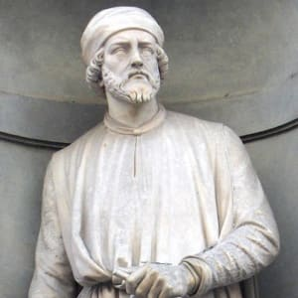
Renaissance
Donato di Niccolò di Betto Bardi
1386 – 1466

Slide 22
David

Slide 23
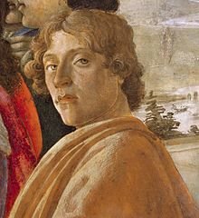
Renaissance
Sandro Botticelli
1445 -1510

Slide 24
The Birth of Venus

Slide 27
Still-Life Painting in Southern Europe, 1600–1800

Slide 28
The Afternoon Meal (La Merienda) Luis Meléndez (Spanish, Naples 1716–1780 Madrid)

Slide 29
CARAVAGGIO AND CARAVAGGISTI IN 17THCENTURY EUROPE

Slide 30
Caravaggio Still Life Paintings Filetommaso Salini – Still-Life With Fruit, Vegetables And Animals

Slide 31
Italian Renaissance Landscape Painting

Slide 32
Landscape with the Funeral of Phocion Nicolas Poussin, 1648

Slide 33
Veduta of Delphi, with a sacrificial procession, Claude Lorrain, 1645

Slide 34
Work of art by Suan Sunandha Rajabhat University students

Slide 37
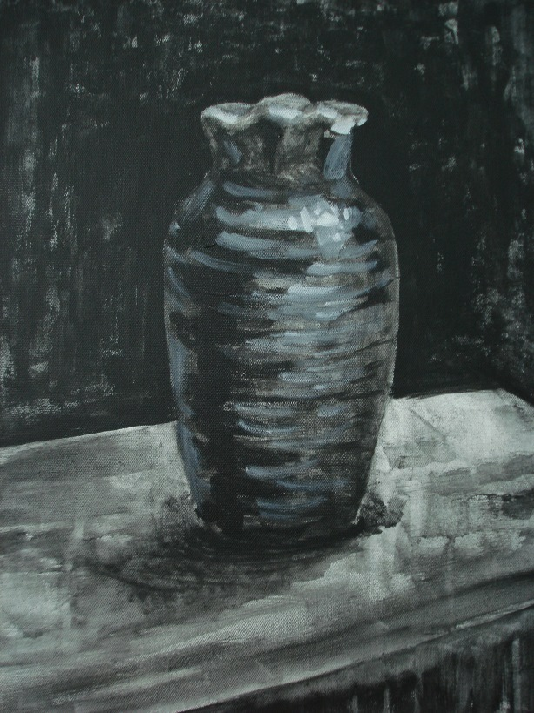

Slide 38
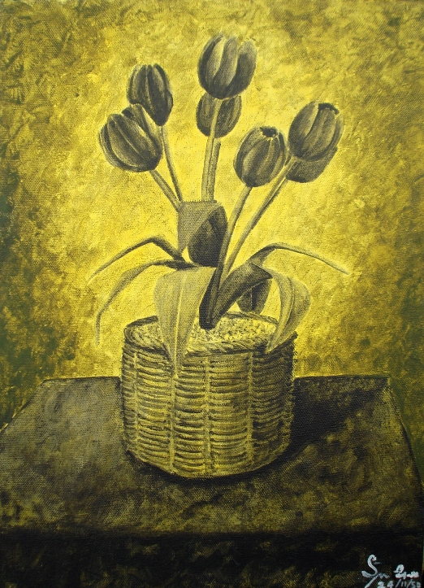

Slide 39
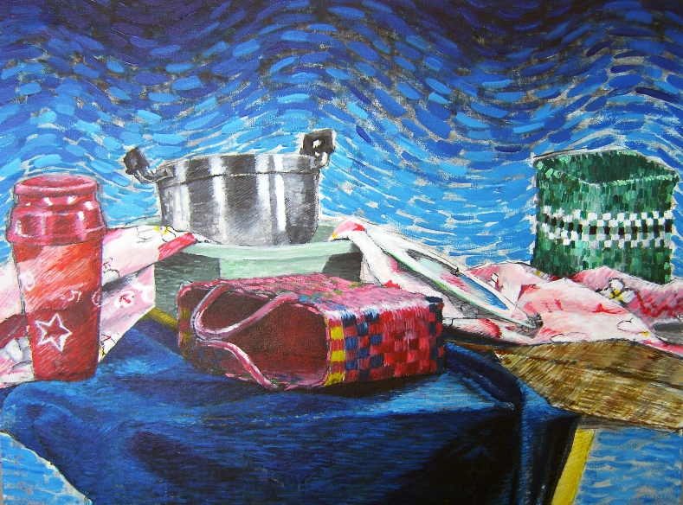

Slide 40
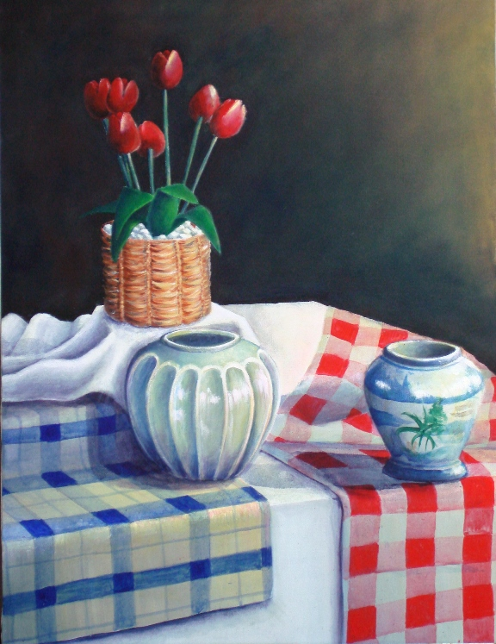

Slide 41
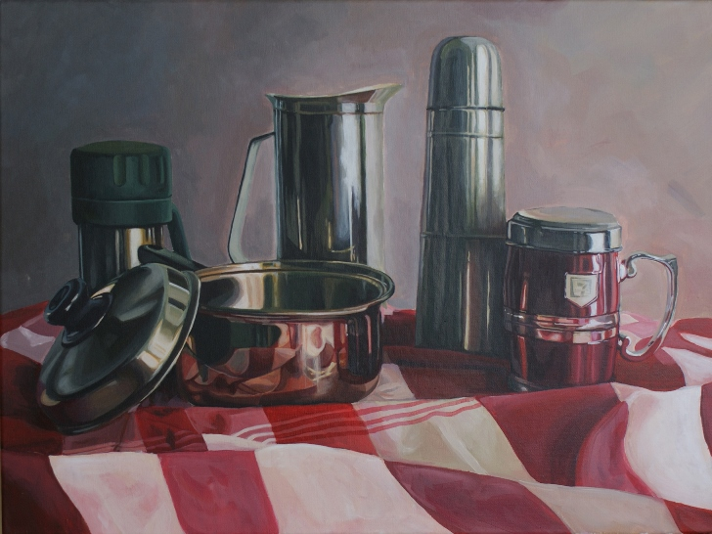

Slide 42
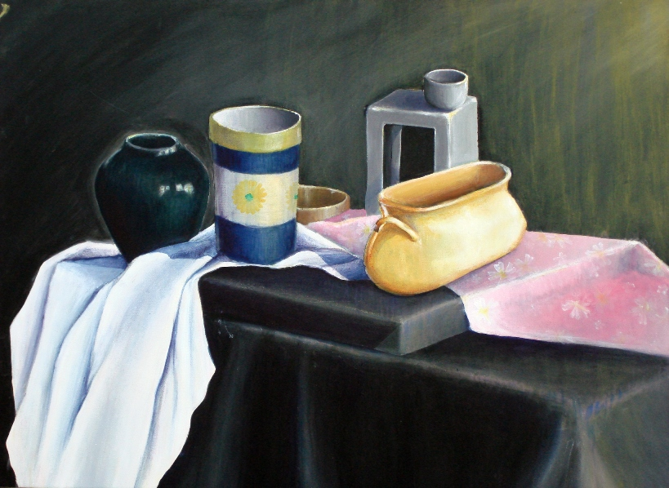

Slide 43
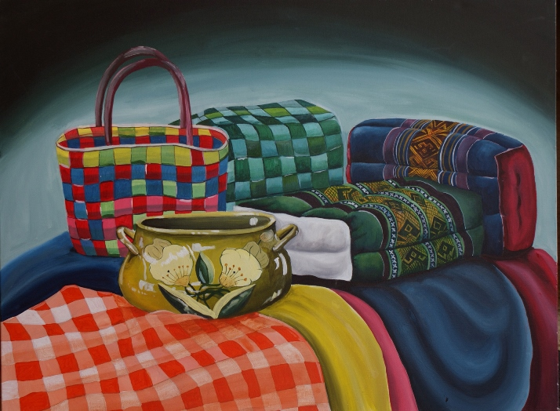

Slide 44
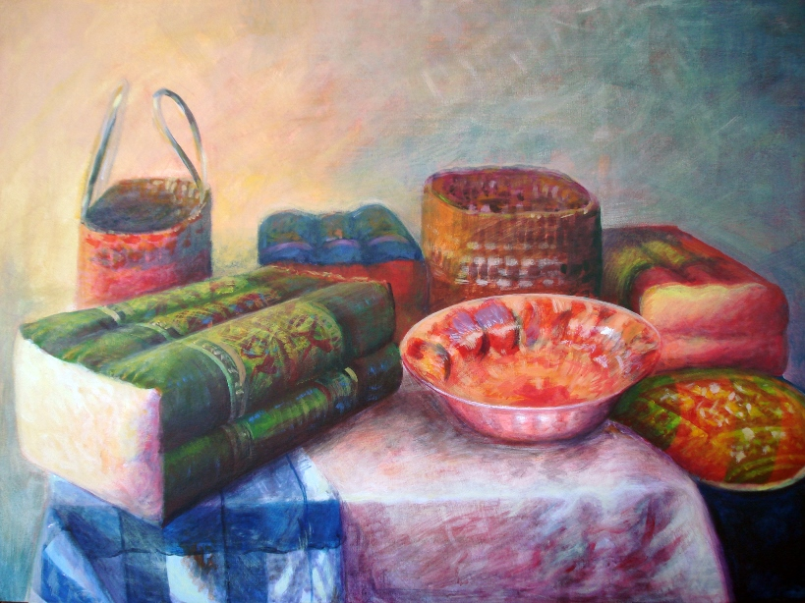

Slide 45
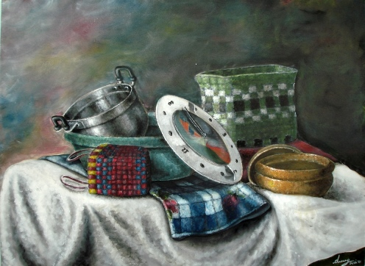

Slide 46
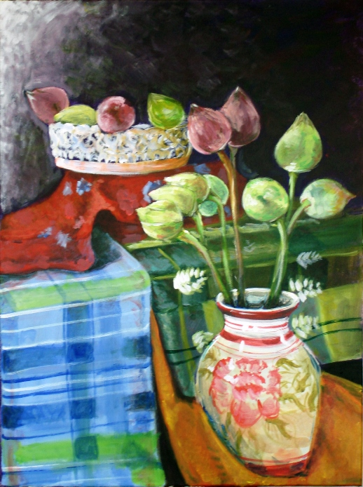

Slide 47
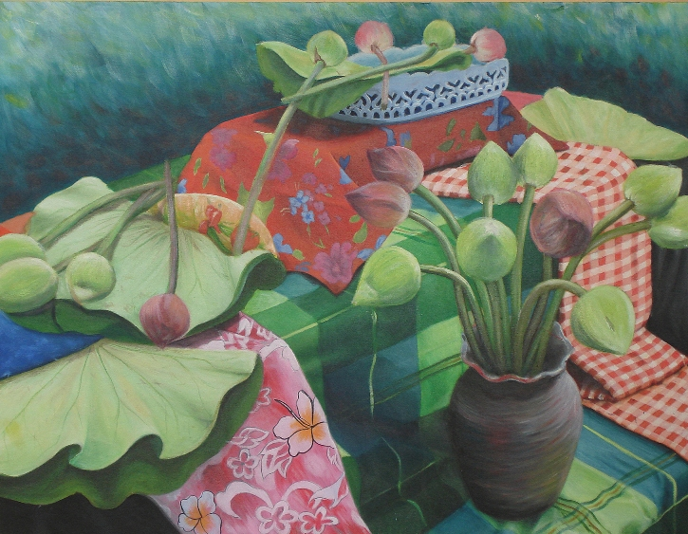

Slide 48
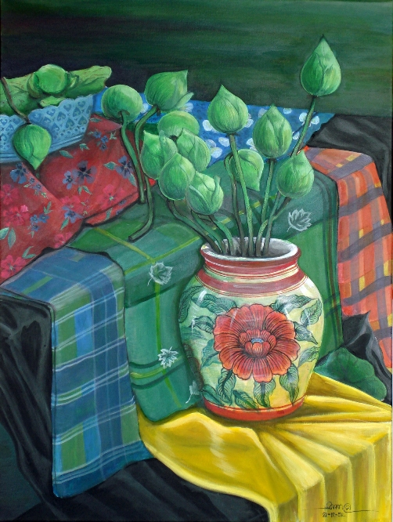

Slide 49
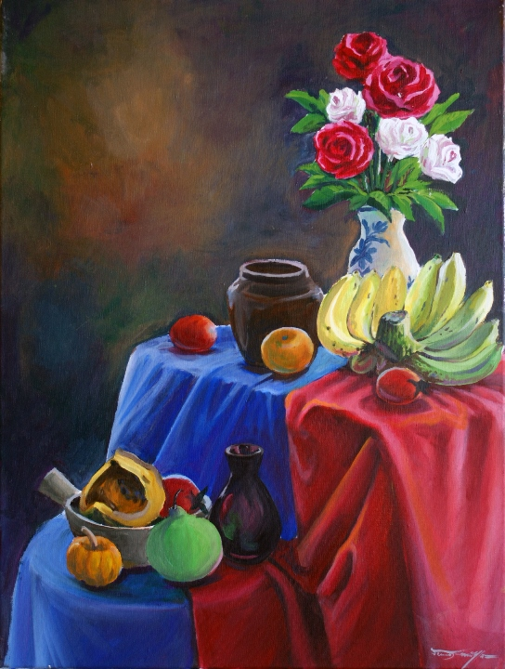

Slide 50
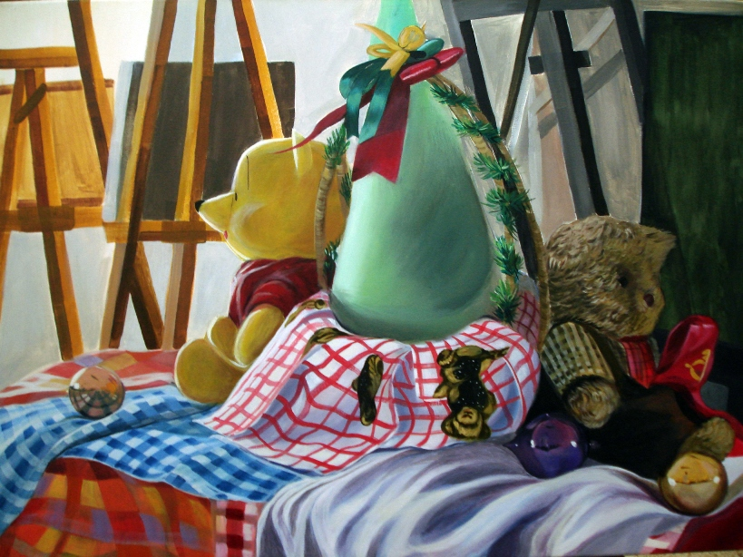

Slide 51
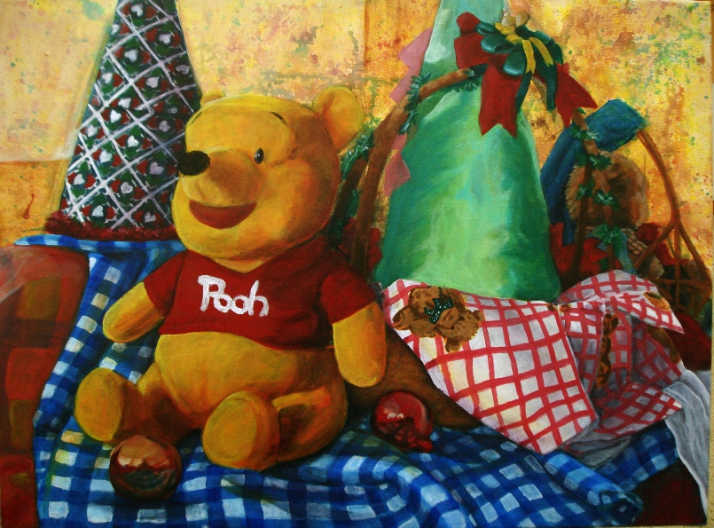

Slide 52
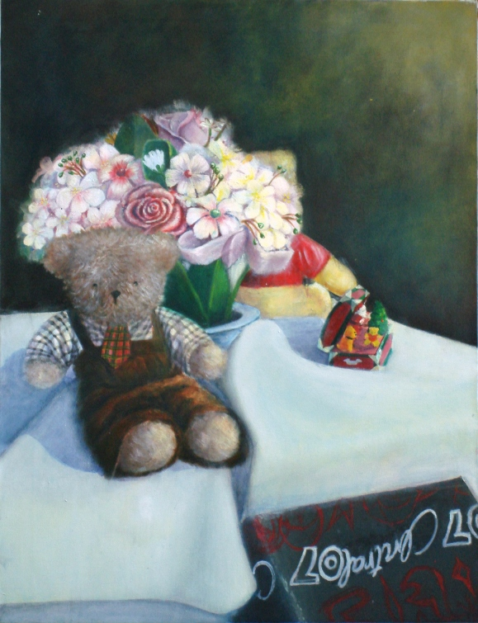

Slide 53
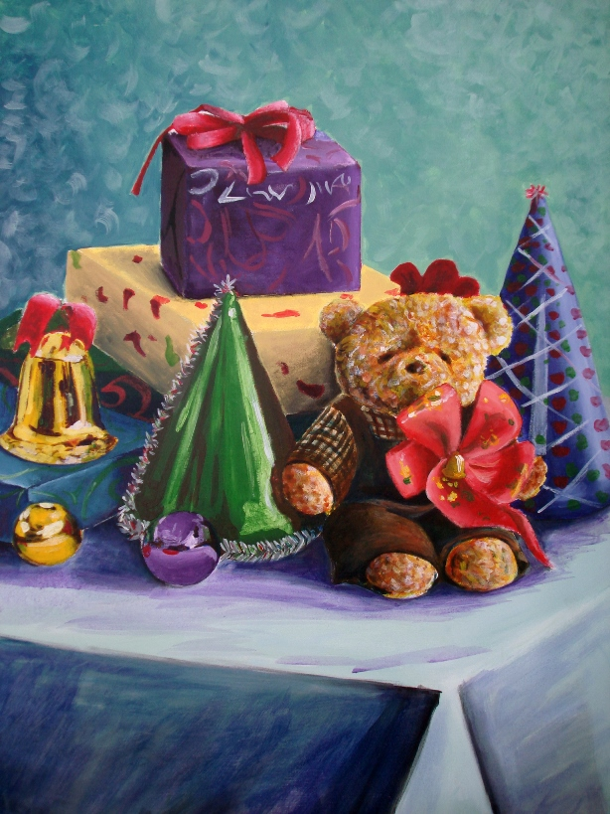

Slide 54
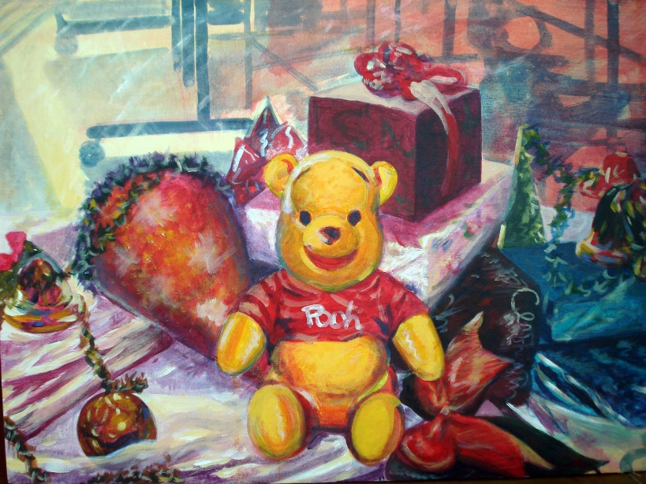

Slide 55
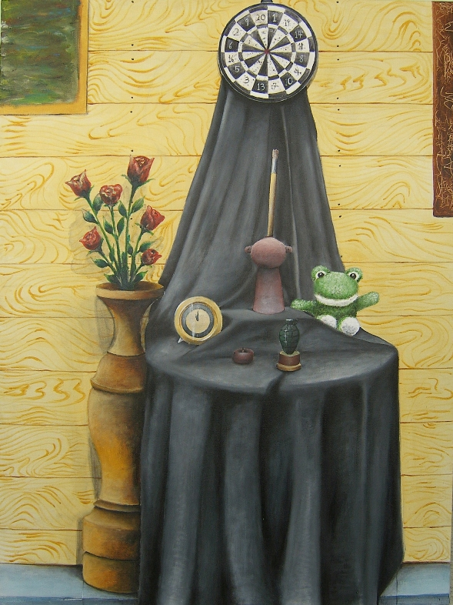

Slide 56
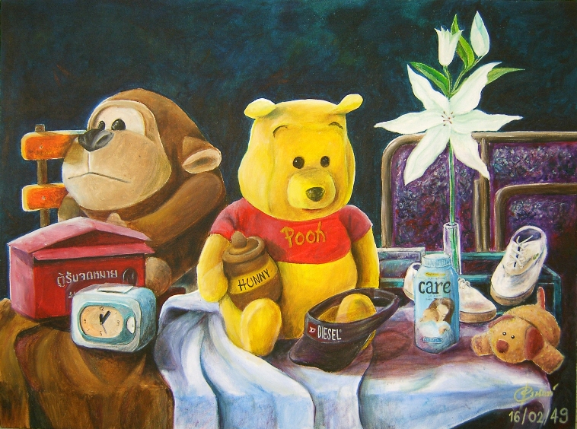

Slide 57
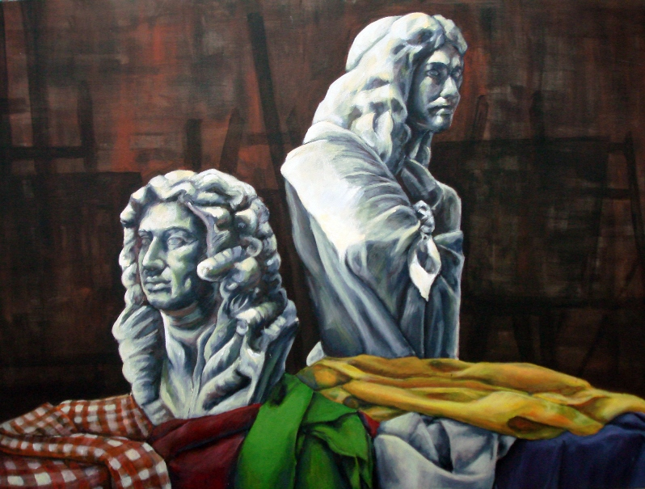

Slide 58
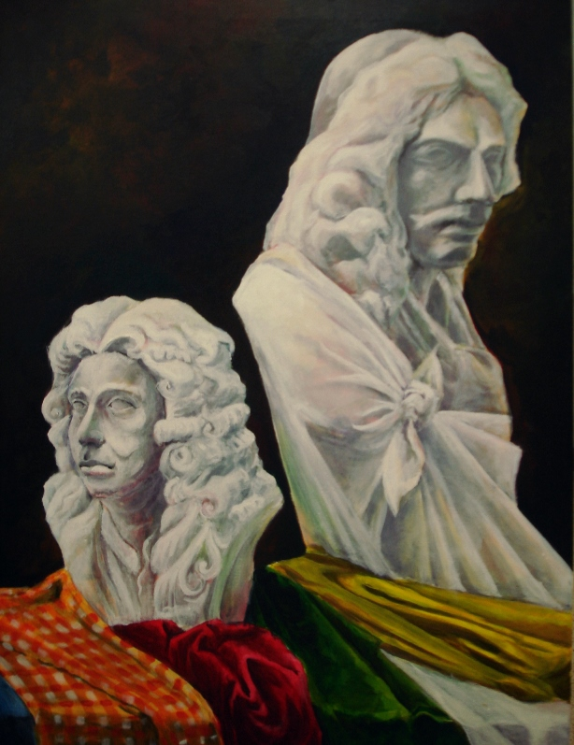

Slide 59
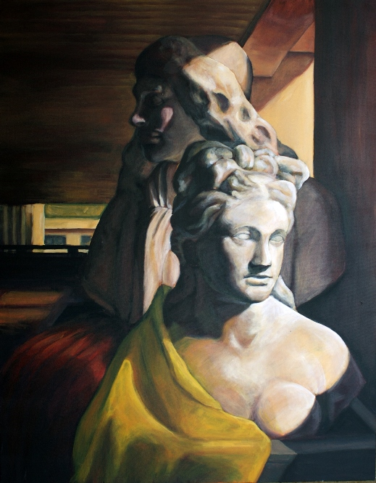

Slide 60
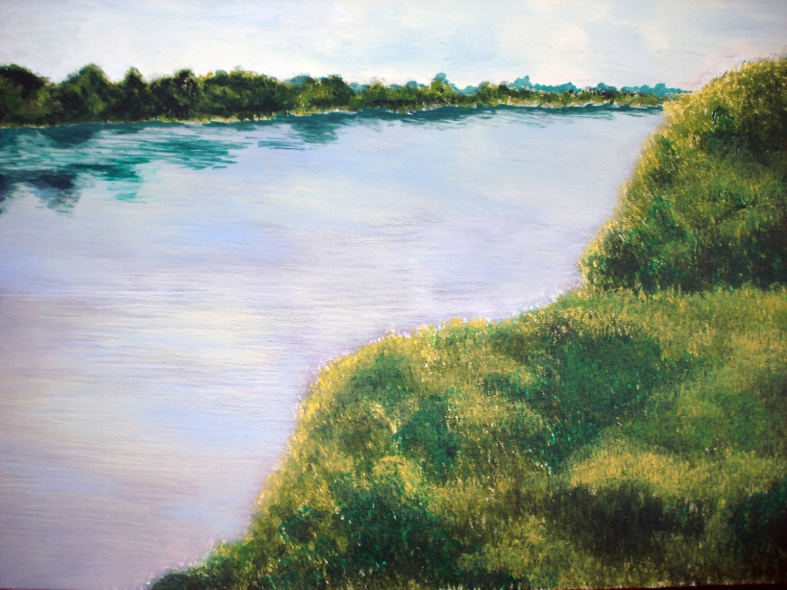

Slide 61
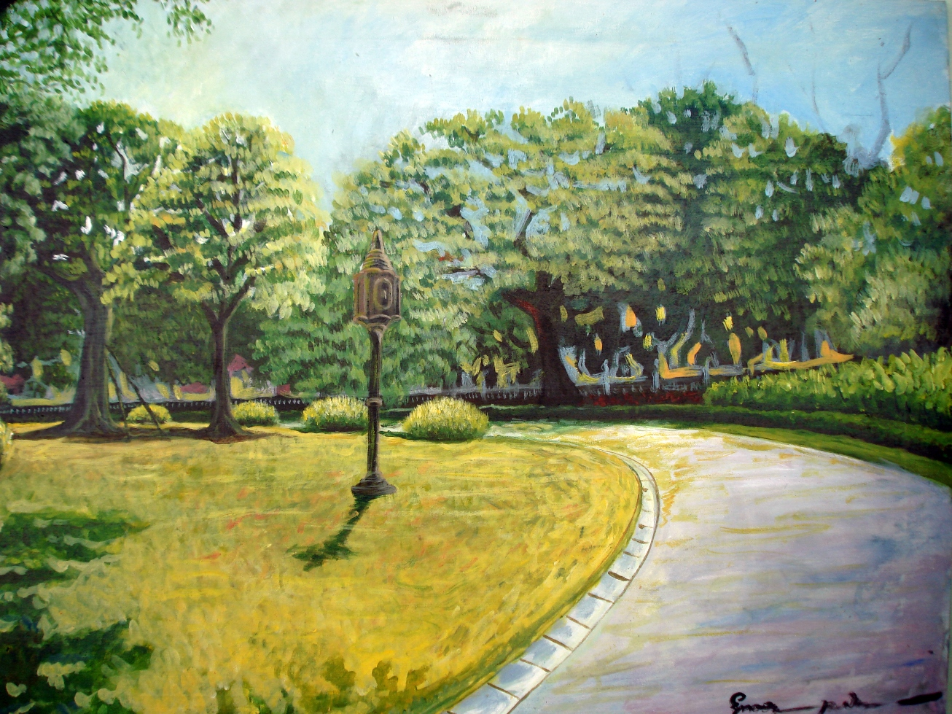

Slide 62
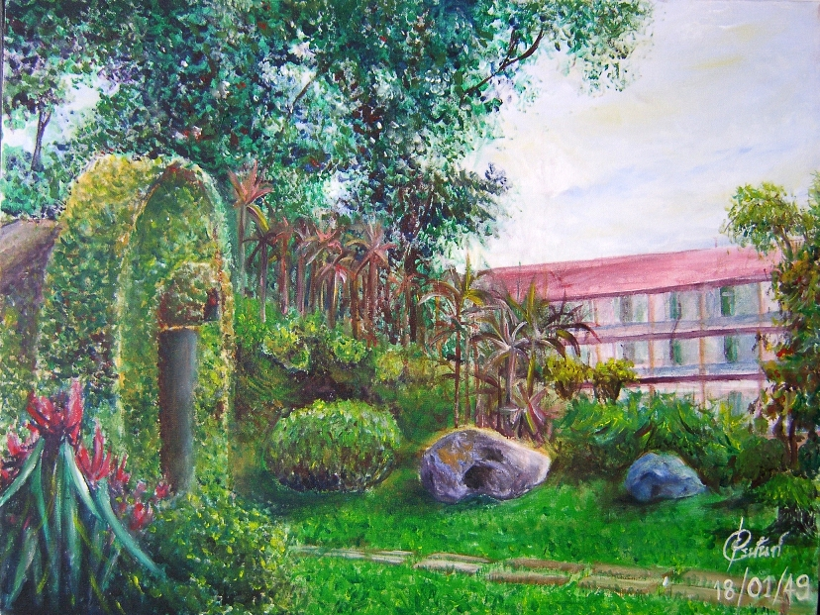

Slide 63
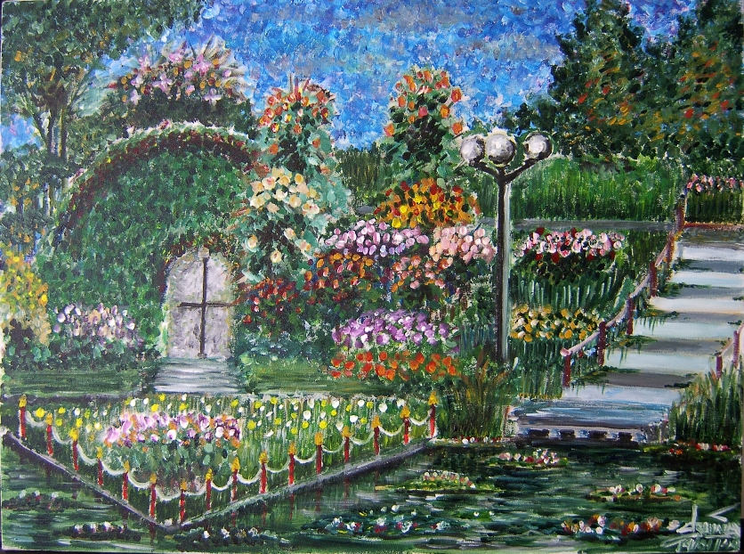

Slide 64
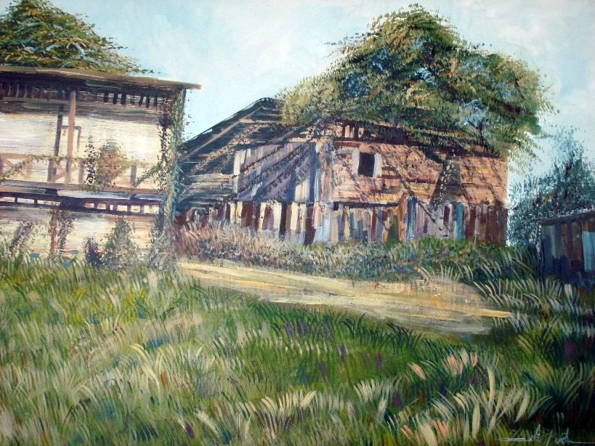

Slide 65
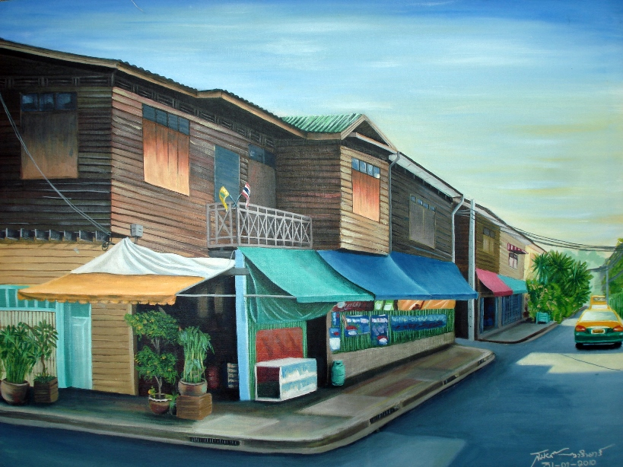

Slide 66
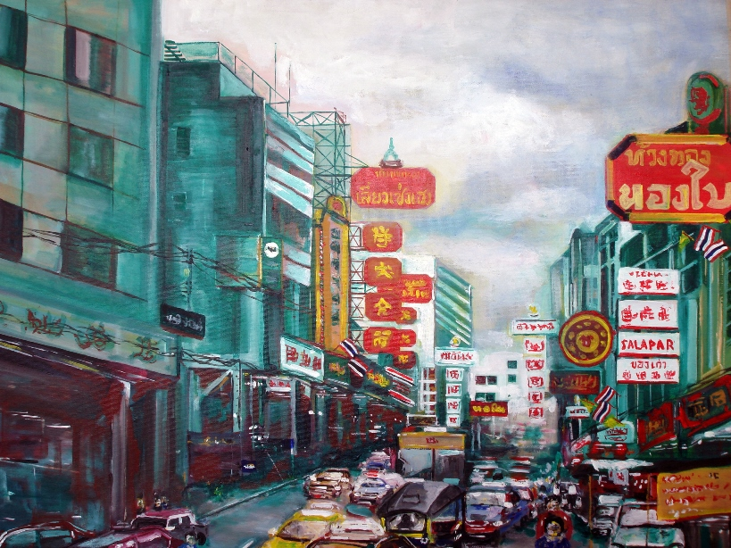

Slide 67
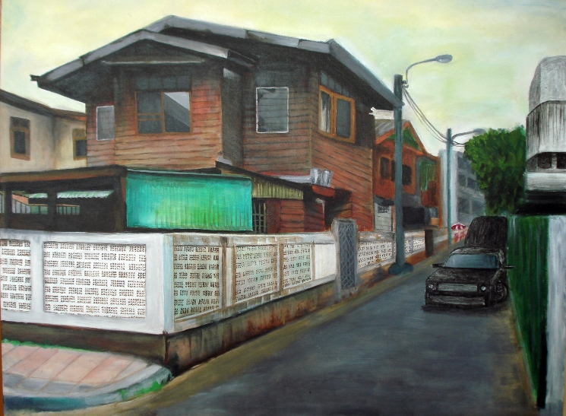

Slide 68
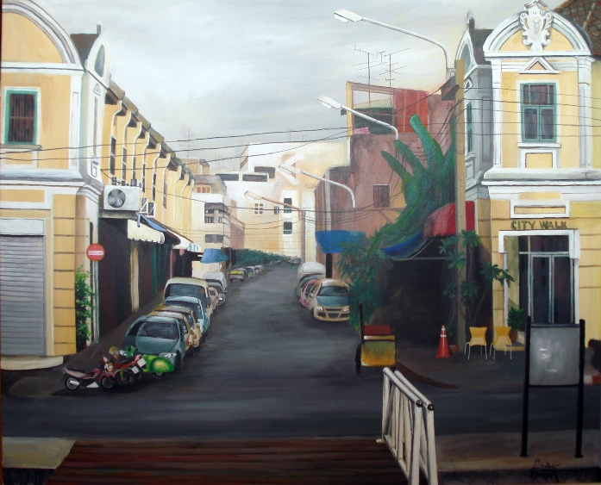

Slide 69
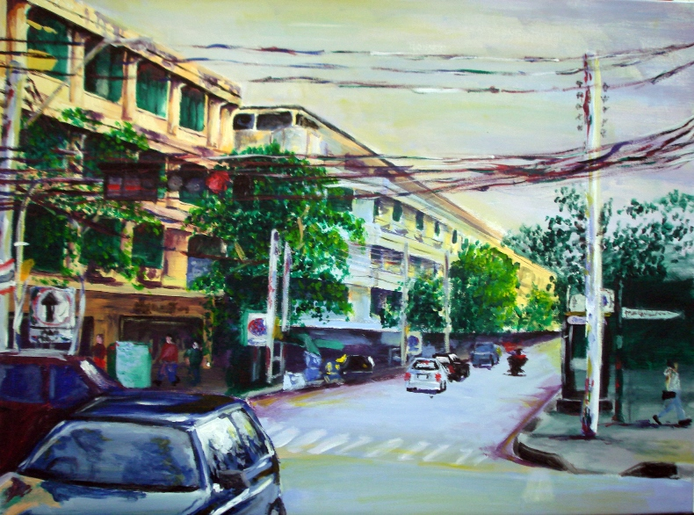

Slide 70
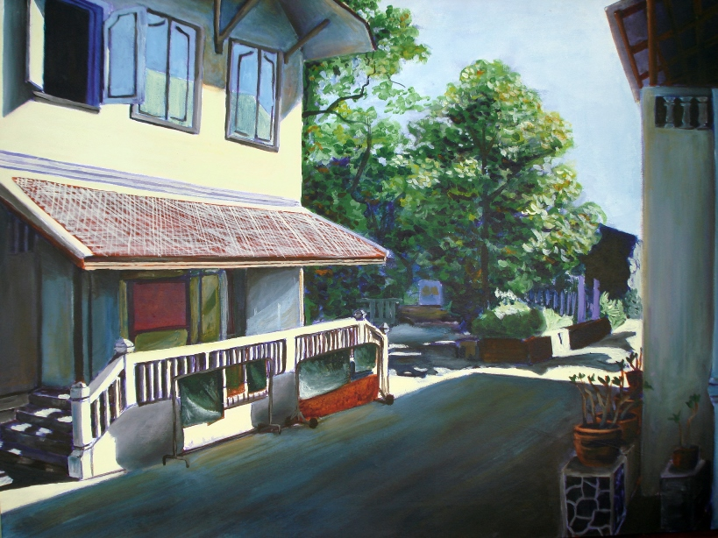

Slide 71
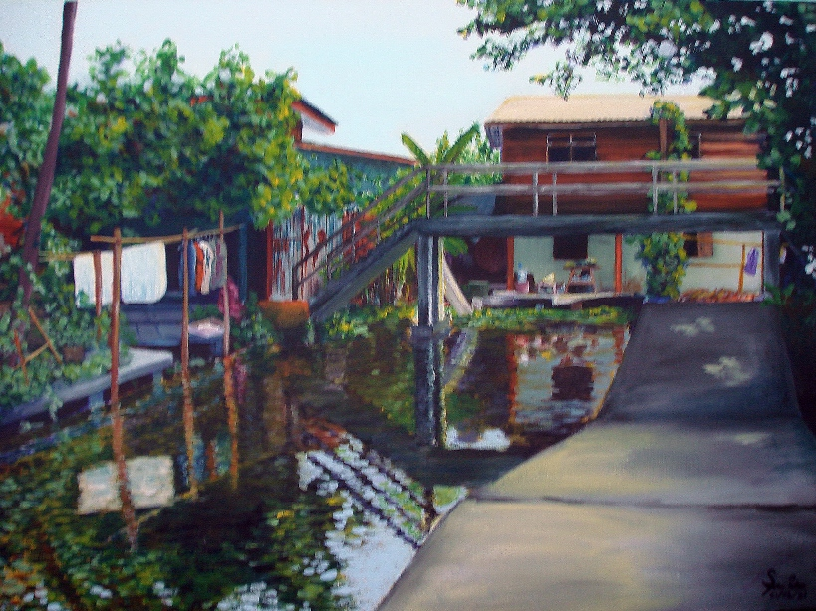

Slide 72
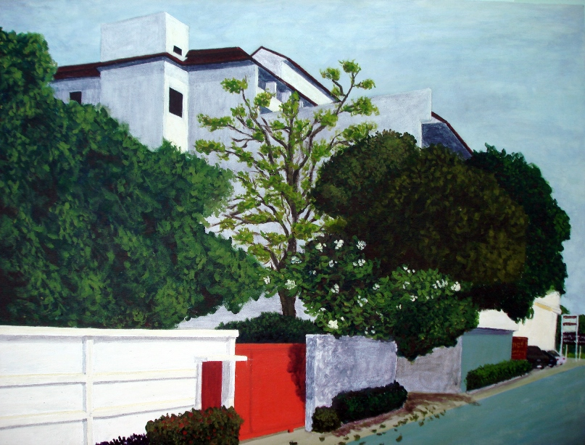

Slide 73
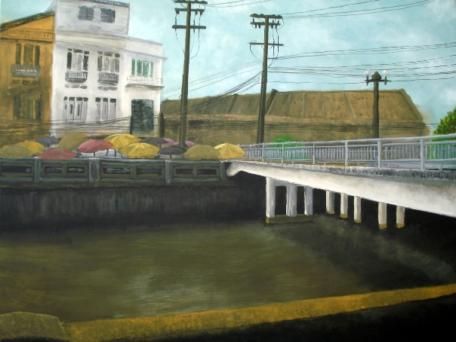

Slide 74
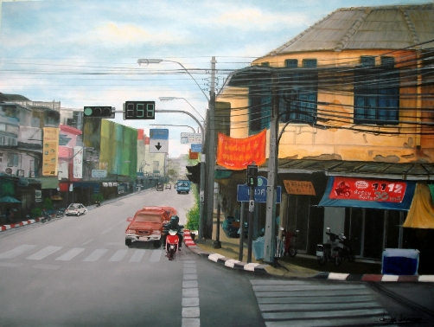

Slide 75
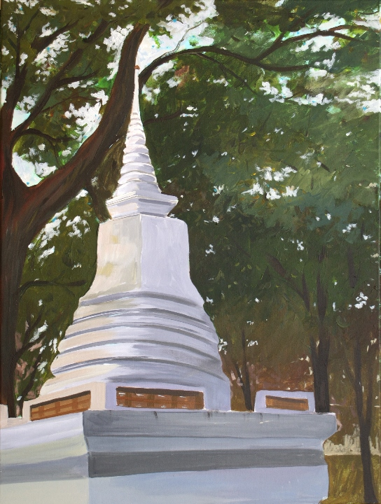

Slide 76
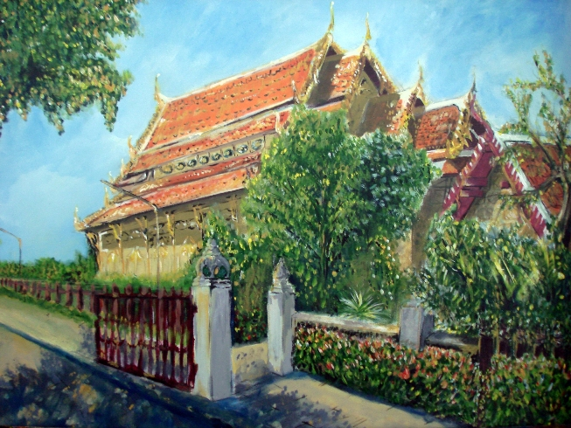

Slide 77
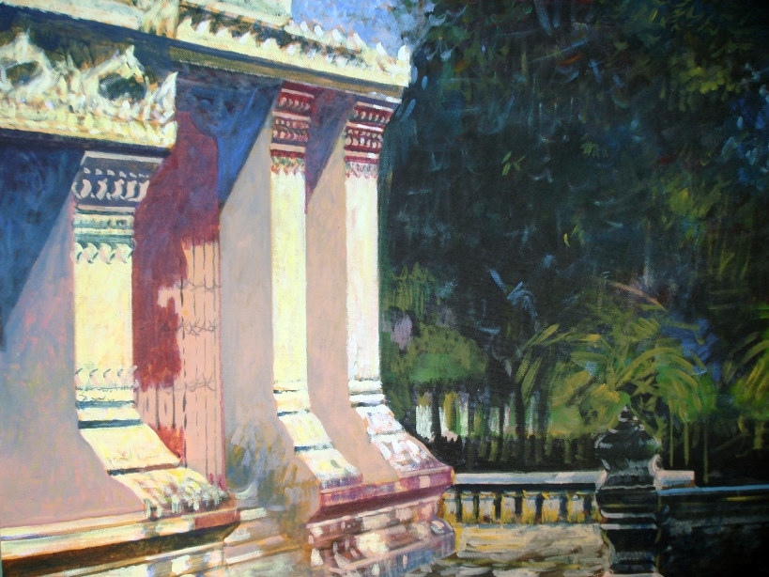

Slide 78
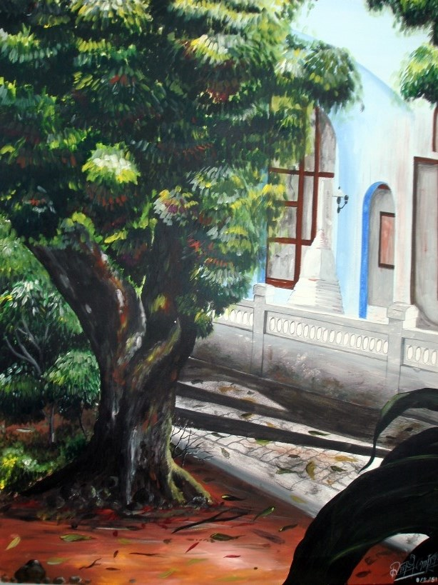

Slide 79
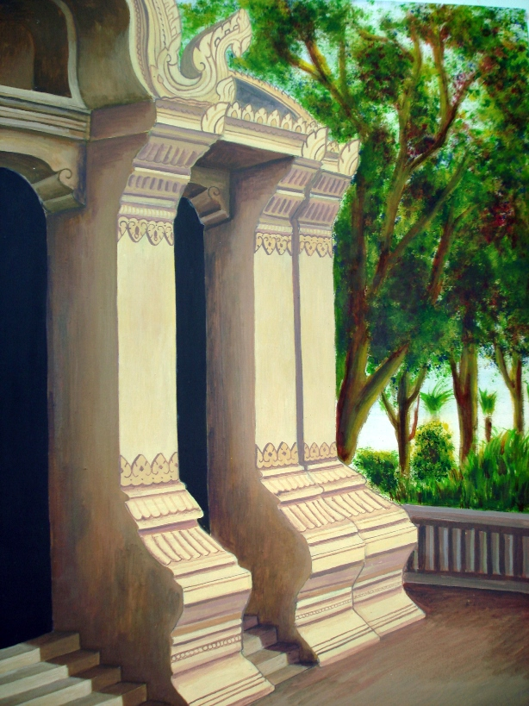

Slide 80
