Slide 1
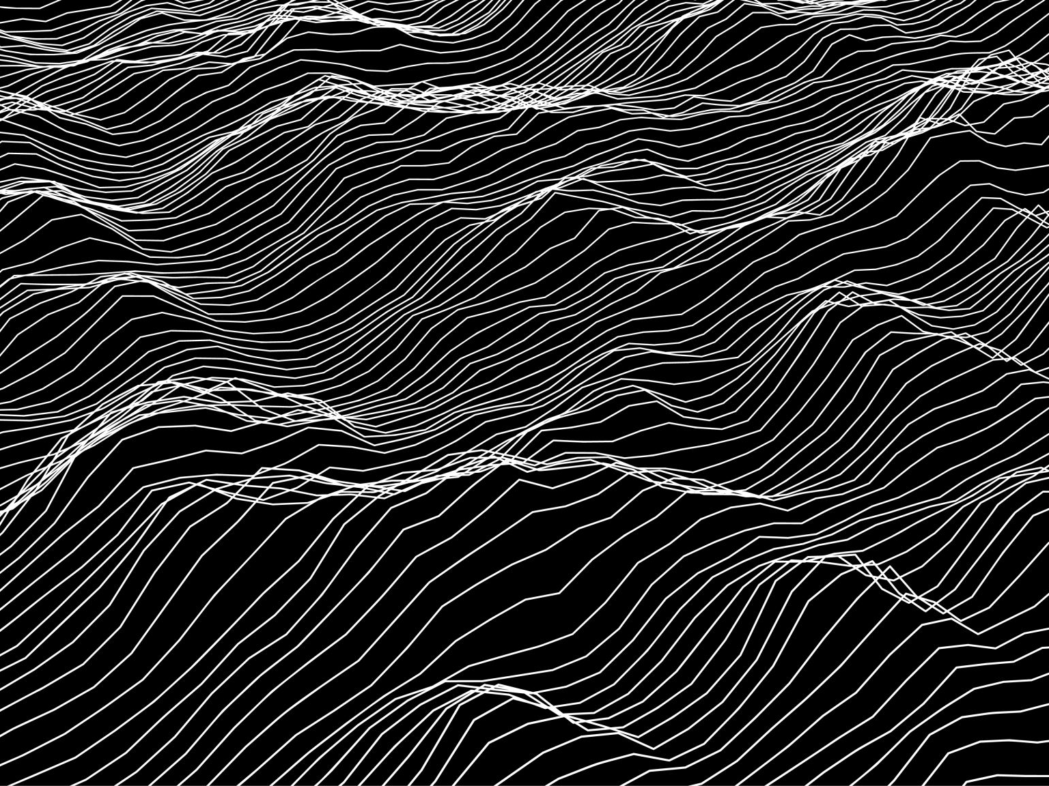
PAI1102 Drawing2 2/2565 asst.prof.dr. pisit puntien

Slide 2
Introduction
•-Guidelines for the creation of line drawings PAI1102 Line Drawing 2 focuses on the use of a variety of materials and strategies. to create dimensions in line drawings
•- Pre-class test Let the students experiment with creating drawings. with materials currently available to students
•-Dimensions in line drawings give different effects by using different types of visual elements such as points, lines, and textures.
•- materials and tactics Have students follow the creative topics. and to search for materials and strategies for students to study and experiment on their own

Slide 4
Cave Art

Slide 5
Chauvet Cave 37,000 – 33,500 B.C.

Slide 6
Chauvet Cave 37,000 – 33,500 BC

Slide 7
Chauvet Cave 37,000 – 33,500 BC

Slide 8
Chauvet Cave 37,000 – 33,500 BC

Slide 9
Chauvet Cave 37,000 – 33,500 BC

Slide 10
Chauvet Cave 37,000 – 33,500 BC

Slide 11
Chauvet Cave 37,000 – 33,500 BC

Slide 12
Chauvet Cave 37,000 – 33,500 B.C.

Slide 13
Chauvet Cave 37,000 – 33,500 BC

Slide 14
Altamira Cave 34,000 BC.

Slide 15
Altamira Cave 34,000 BC.

Slide 16
Altamira Cave 34,000 BC.

Slide 17
Altamira Cave 34,000 BC.

Slide 18
Altamira Cave 34,000 BC.

Slide 19
Altamira Cave 34,000 BC.

Slide 20
Altamira Cave 34,000 BC.

Slide 21
Lascaux Cave 15,000 B.C.

Slide 22
Lascaux Cave 15,000 B.C.

Slide 23
Lascaux Cave 15,000 B.C.

Slide 24
Lascaux Cave 15,000 B.C.

Slide 25
Lascaux Cave 15,000 B.C.

Slide 26
Lascaux Cave 15,000 B.C.

Slide 27
Lascaux Cave 15,000 B.C.

Slide 28
Jean Auguste Dominique Ingres Mademoiselle Mary de Borderieux

Slide 29
Jean Auguste Dominique Ingres

Slide 30
Jean Auguste Dominique Ingres

Slide 31
Jean Auguste Dominique Ingres

Slide 32
Andrey Samarin

Slide 33
Jean Auguste Dominique Ingres

Slide 34
Work of art by suan sunandha Rajabhat university students

Slide 36
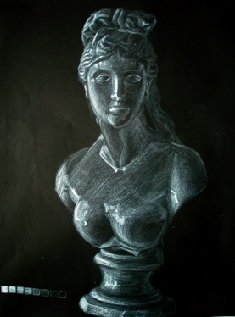

Slide 37
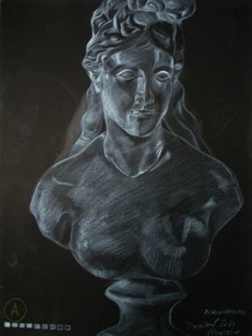

Slide 38
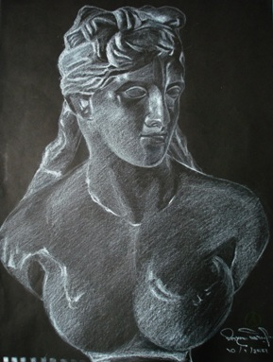

Slide 39
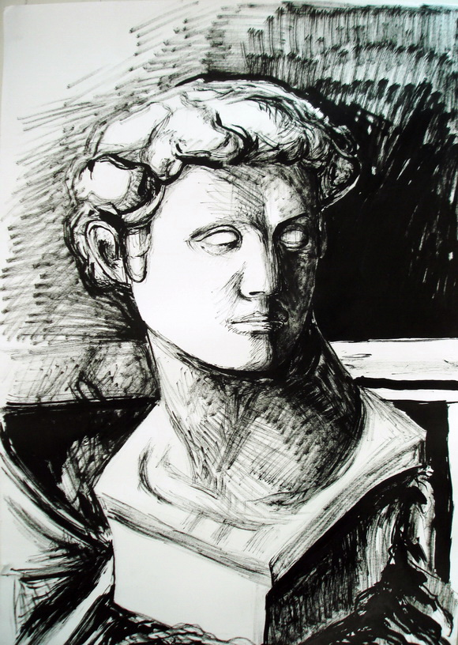

Slide 40
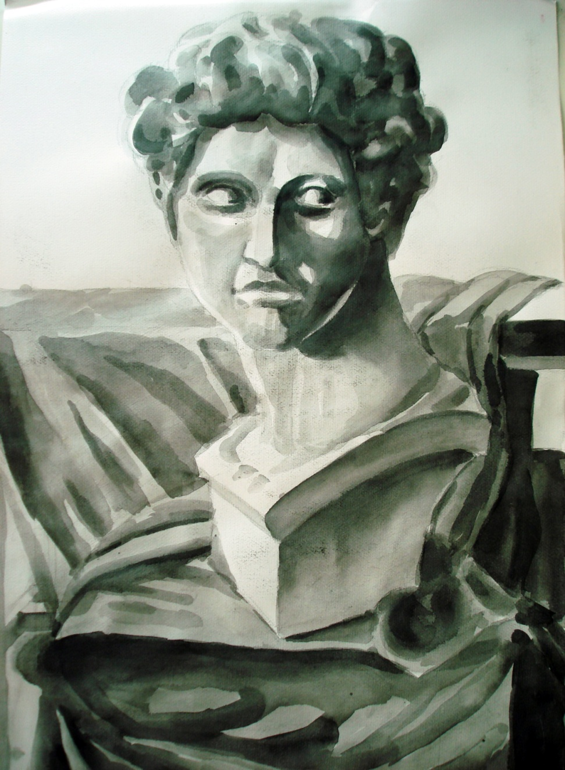

Slide 41
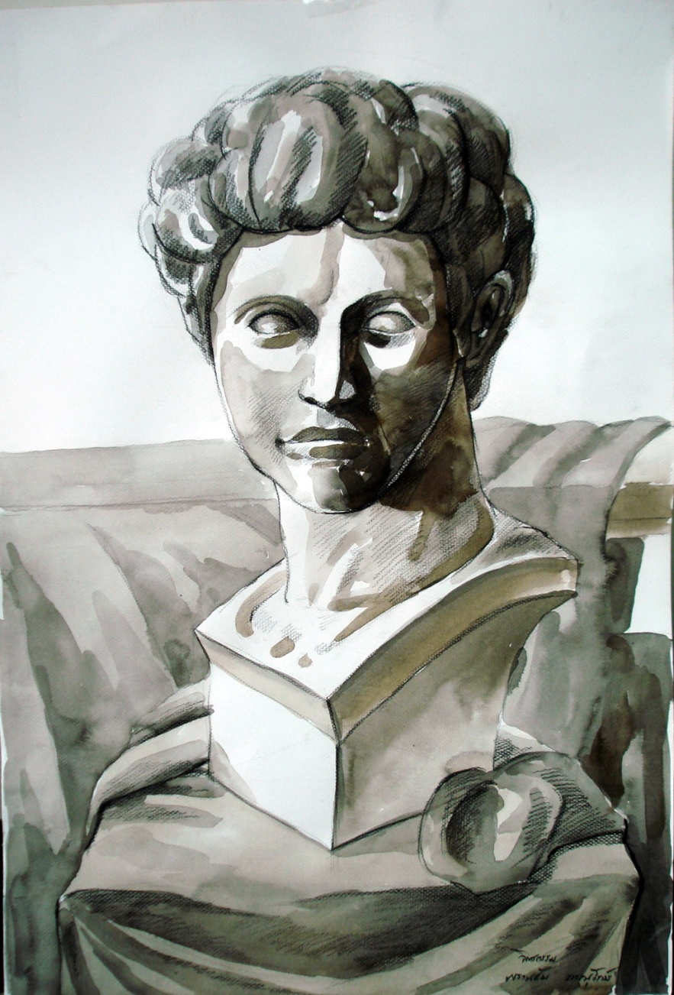

Slide 42
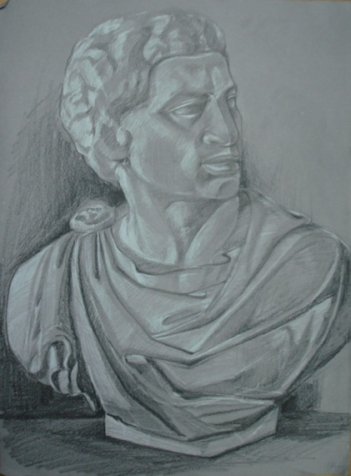

Slide 43
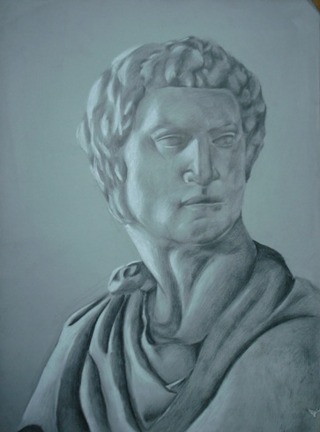

Slide 44
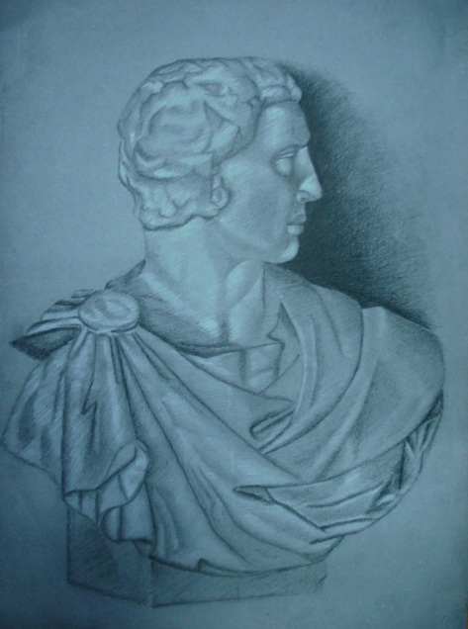

Slide 45
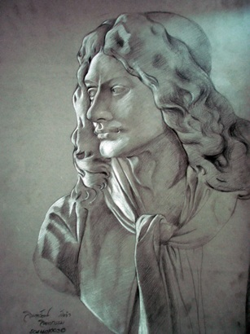

Slide 46
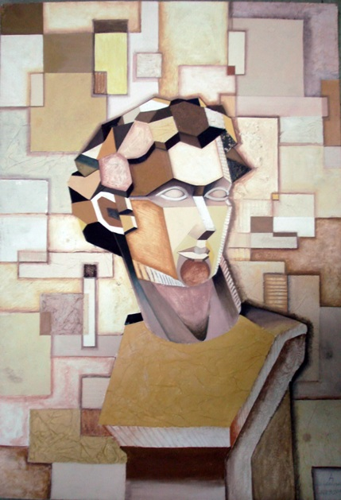

Slide 47
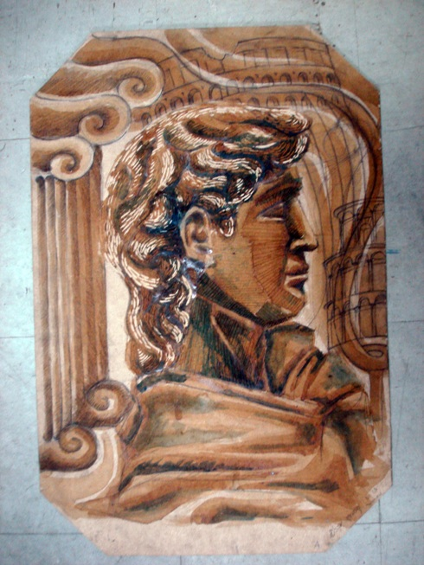

Slide 48
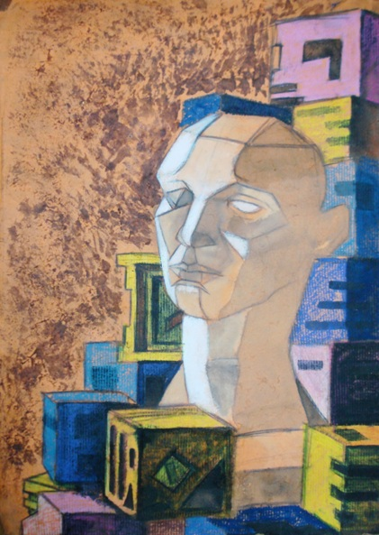

Slide 49
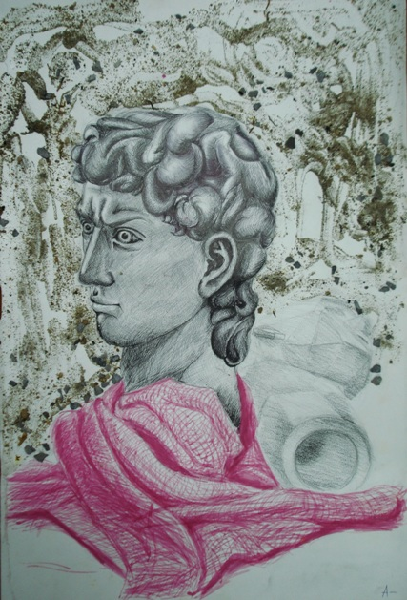

Slide 50
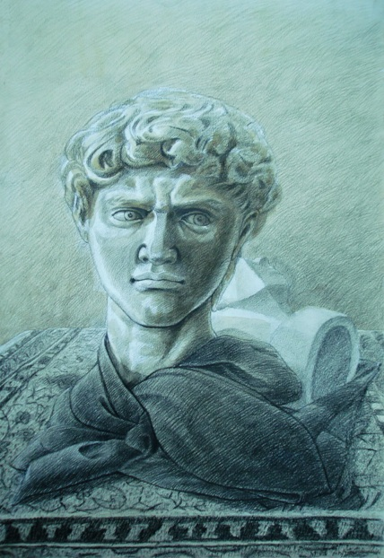

Slide 51
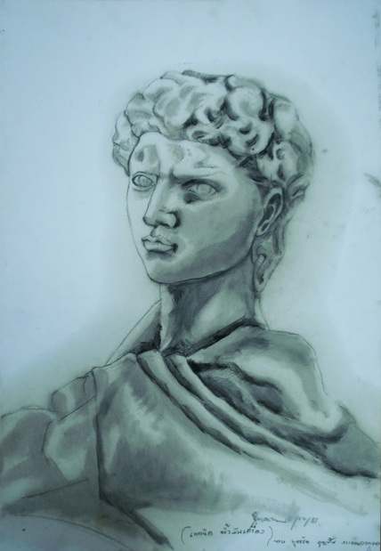

Slide 52
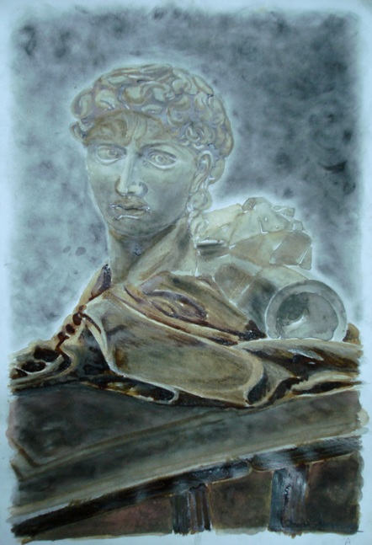

Slide 53
