Slide 1
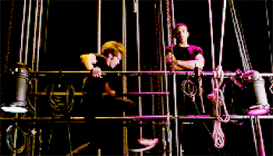
Introduction to Stage Management

Slide 2
What does a Stage Manager do?
Be on top of everything – manage everyone
Scheduler
Conflict diffusers
Delegators
Answer Questions
Line Notes
Call Cues
Facilitate Communication between the Design / Production Team
Tracking for props, scenery, and costumes
Provide supplies to people
Rehearsal Reports, Contact Sheet, Production Meeting Report, etc. etc.
Communication and management of the cast

Slide 3
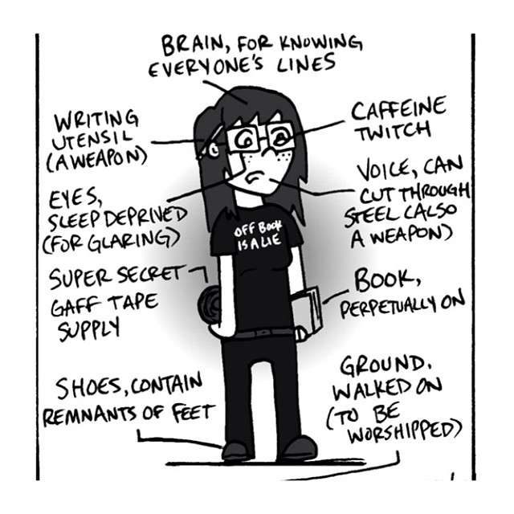
The Anatomy of a Stage Manager

Slide 4
What makes a “good” Stage Manager? Good = effective, successful, prolific, sustainable, respected, well-liked etc.
Organized
Answer your questions or finds the answers
Effective communicator
Empathy and Compassion – UNDERSTANDING
Charisma – approachability
Make people heard – give others a voice
Quick Decision Making under pressure
Problem Solving Skills
Reliable
Even – non alarmist – efficient, staying calm under pressure
Reasonable

Slide 5
Major Role of the Stage Manager
To facilitate the organization and communication necessary for the rehearsal and execution of a theatrical production.

Slide 6
Communication Principles
Meta Theatrical Observation Exercise
Discuss what makes good communication
Observe the communication techniques of your group
As a group make a list of 5 essential qualities of “good” communication
As an individual write
3 moments of “good communication” – what worked?
2 moments of “inferior communication” – what didn’t work?

Slide 7
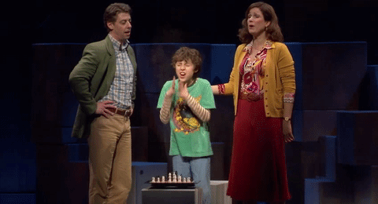
What did you discuss and observe?

Slide 8
It’s the Way You Say It, Carol A. Fleming
”What is self-expression? It means that you say what you want to say in the manner that comes to you naturally. It will be your take on the matter, in the words you normally use, perhaps with the narrative flow of your experience. It’s a solo performance in front of people with 100 percent of your attention on finding and speaking your thoughts, as opposed to communication where the listener is foremost in your mind as you speak. You speak their language, you speak to their concerns, and you get to the point insofar as it concerns them.”
How does this affect the way you think about communicating as a stage manager?

Slide 9
What are an SM’s three guiding principles?
TACTFUL, TIMELY, AND SPECIFIC
Practically apply this to specific situations (in the past or hypothetical).

Slide 10
Face to Face Communication
What’s important to consider and remember?
Don’t make it an intervention or and embarrassing situation
Be aware of location and external audience
“Think before you speak” – know what you want to say
Tone, attitude, eye contact,
Finding Balance between empathy and authority
Personal Experiences?

Slide 11
Written Communication
What’s important to remember and consider?
Visual Organization- Fonts, Colors, Layout
Know your audience – confirm receipt
Take advantage of opportunity to choose your words
Clarity is incredibly important!
Personal experiences?

Slide 12
Pre-Production
Pre-Production Tasks
Read and analyze the script.
Collect information on the production.
Prepare initial lists and breakdowns.
Create a prompt book.
Meet with the director.
Participate in auditions.
Prepare the rehearsal room.

Slide 13
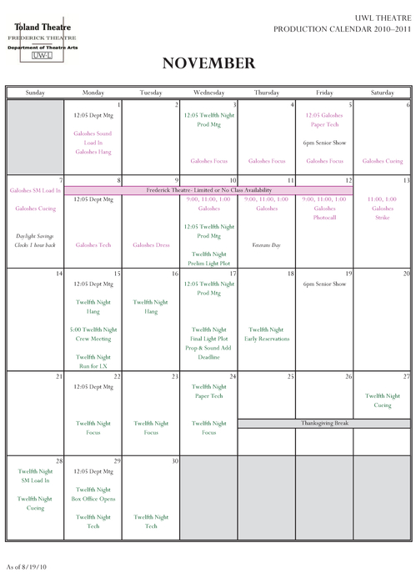
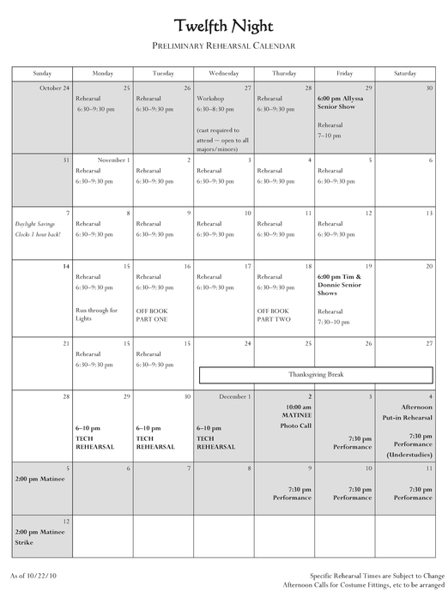
The Calendar
-The Stage Manager must be familiar with both the production calendar and the actor calendar. This includes rehearsals, deadlines for cue sheets, production meetings, and more.

Slide 14
Analyzing the Script in 3 steps
Read the script
Read the script for the script analysis
Read the script for the character/scene breakdown

Slide 15
What is a Script Analysis?
Notes on any and all technical aspects of the show (props, lighting, costumes)
A scene-by-scene notation of specific technical details-- A stage manager can’t remember everything!

Slide 16
What can we infer from this piece of dialogue?
Mary: Gosh it's cold in here.
John: You can borrow that sweater if you want.
Mary: Thanks! I feel much better now.
Recording these details makes remembering everything you need much easier when production rolls around! Don’t record any extra details, stick to the script!

Slide 17
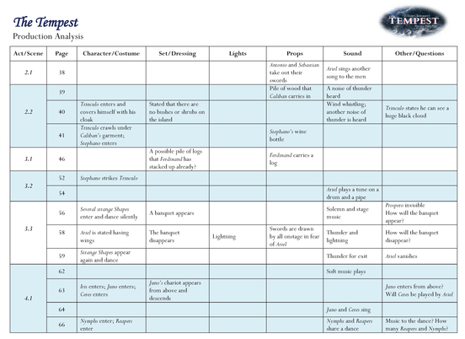

Slide 18
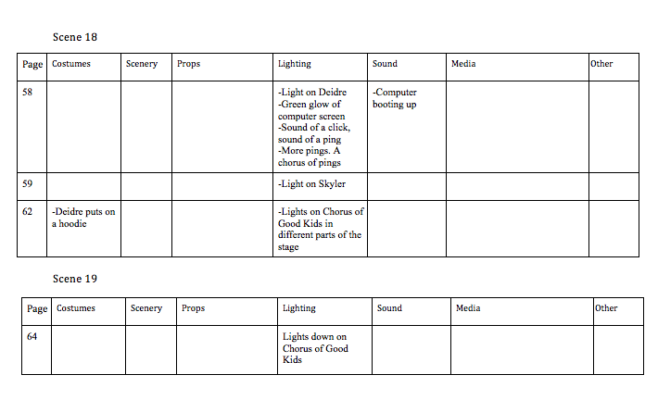

Slide 19
What is a character/scene breakdown?
A page-by-page detailing of who is on stage when (and when they enter/exit)
Can also be done on a scene-to-scene basis.
Use different colors and fonts to make the breakdown easier to read

Slide 20
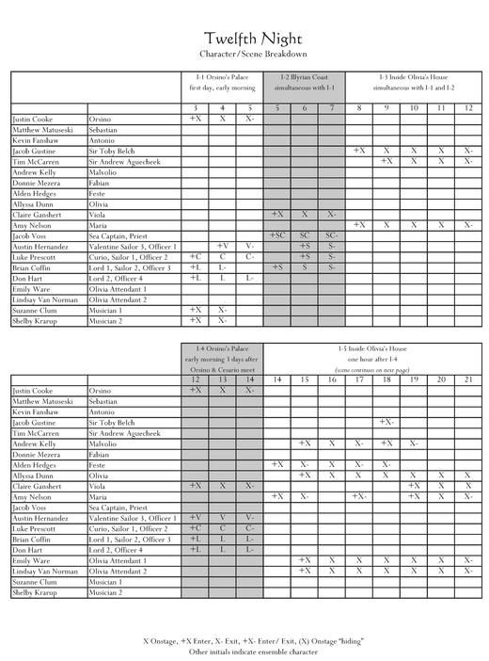

Slide 21
