Slide 1
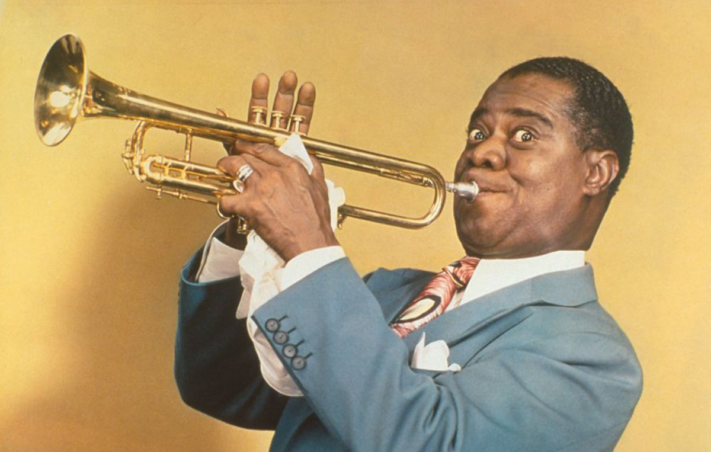
Principle of Chord
Diatonic Chord
กฤตวิทย์ ภูมิถาวร อาจารย์ประจำสาขาวิชาดนตรี คณะศิลปกรรมศาสตร์ มหาวิทยาลัยราชภัฏสวนสุนันทา

Slide 2
Major
Minor
Dominant
Diminished
Augmented
Sus

Slide 3
Major Chord
Major Triad
Major 6/9
Major 6th
Major 7
Major 13
Major 9
Major 7#11

Slide 4
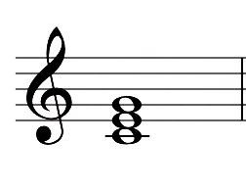
Major Triad
1-3-5 | C-E-G

Slide 5
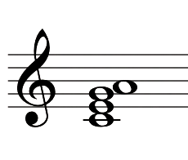
Major 6
1-3-5-6 | C-E-G-A

Slide 6
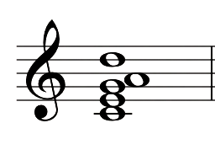
Major 6/9
1-3-5-6-9 | C-E-G-A-D

Slide 7
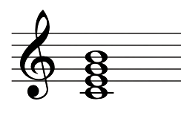
Major 7
1-3-5-7 | C-E-G-B

Slide 8
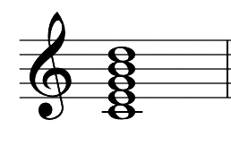
Major 9
1-3-5-7-9 | C-E-G-B-D

Slide 9
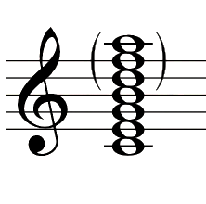
Major 13
1-3-5-7-(9)-(11)-13 | C-E-G-B-(D)-(F)-A

Slide 10
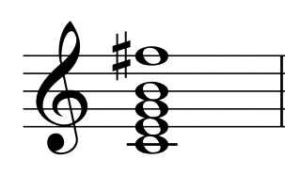
Major 7#11
1-3-5-7-#11 | C-E-G-B-F#

Slide 11
Minor Chord
Minor Triad
Minor 6th
Minor 6/9
Minor 7
Minor 9
Minor 11
Minor 7b5
*half Diminished

Slide 12
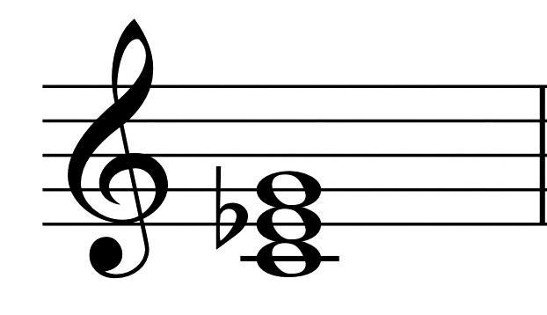
Minor Triad
1-b3-5 | C-Eb-G

Slide 13
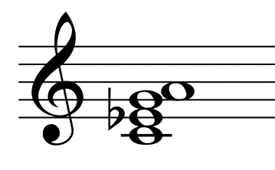
Minor 6th
1-b3-5-6 | C-Eb-G-A

Slide 14
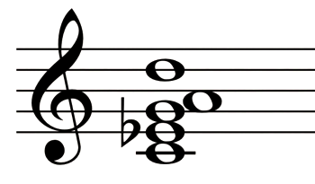
Minor 6/9
1-b3-5-6-9 | C-Eb-G-A-D

Slide 15
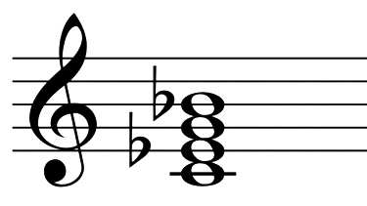
Minor 7
1-b3-5-b7 | C-Eb-G-Bb

Slide 16
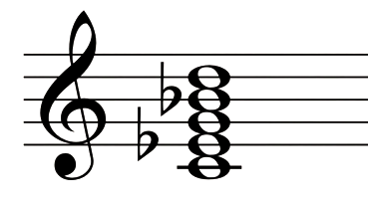
Minor 9
1-b3-5-b7-9 | C-Eb-G-Bb-D

Slide 17
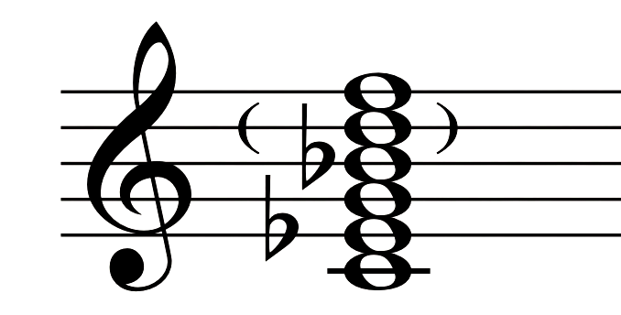
Minor 11
1-b3-5-b7-(9)-11 | C-Eb-G-Bb-(D)-F

Slide 18
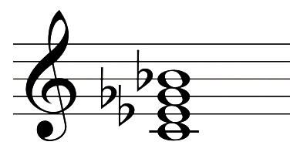
Minor 7b5
*half Diminished
1-b3-b5-b7 | C-Eb-Gb-Bb

Slide 19
Dominant
Dominant 7th
Dominant 9th
Dominant 11th
Dominant 13th
Dominant 7th #11

Slide 20
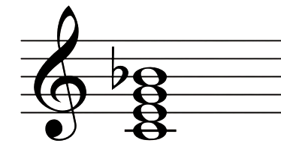
Dominant 7th
1-3-5-b7 | C-E-G-Bb

Slide 21
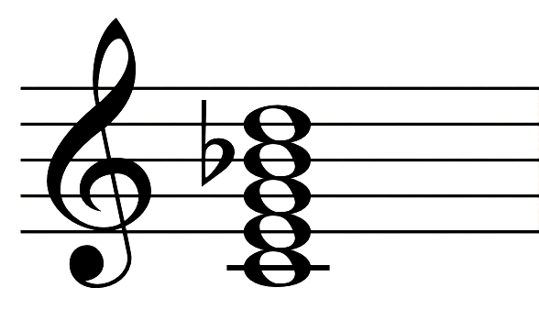
Dominant 9th
1-3-5-b7-9 | C-E-G-Bb-D

Slide 22
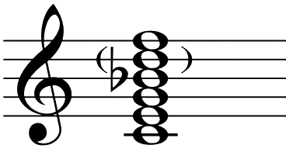
Dominant 11th
1-3-5-b7-(9)-11 | C-E-G-Bb-(D)-F

Slide 23
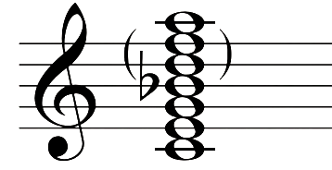
Dominant 13th
1-3-5-b7-(9)-(11)-13 | C-E-G-Bb-(D)-(F)-A

Slide 24
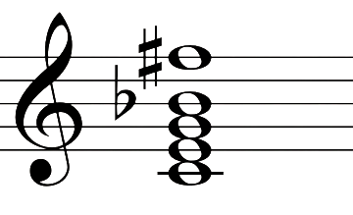
Dominant 7th #11
1-3-5-b7-#11 | C-E-G-Bb-F#

Slide 25
Diminished
Diminished Triad
Diminished 7th
Half Diminished 7th
* Minor 7b5

Slide 26
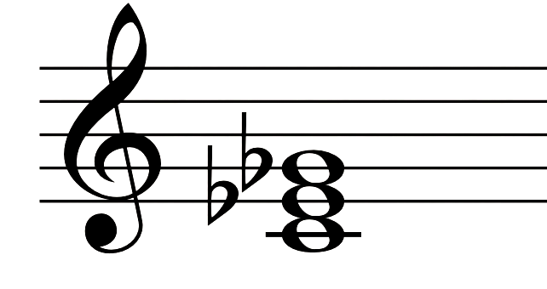
Diminished Triad
1-b3-b5 | C-Eb-Gb

Slide 27
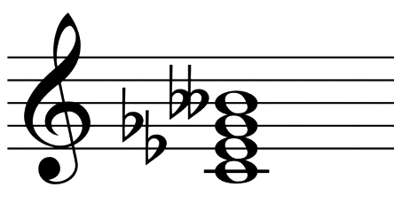
Diminished 7th
1-b3-b5-bb7 | C-Eb-Gb-Bbb

Slide 28
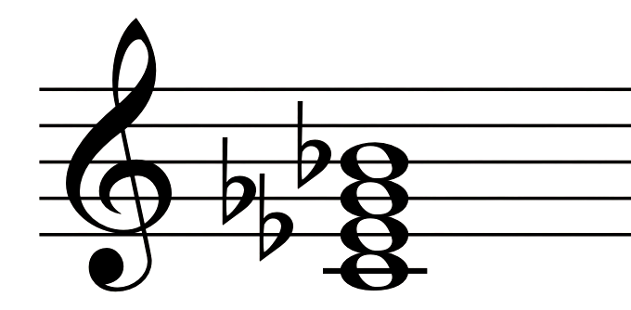
Half Diminished 7th
* Minor 7b5
1-b3-b5-b7 | C-Eb-Gb-Bb

Slide 29
Augmented

Slide 30
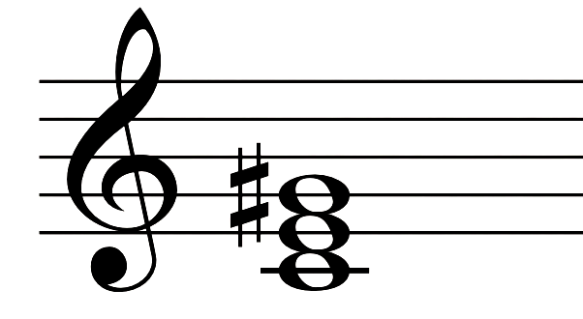
Augmented
1-3-#5 | C-E-G#

Slide 31
Sus
Sus4
Sus2
7Sus4
7Sus2

Slide 32
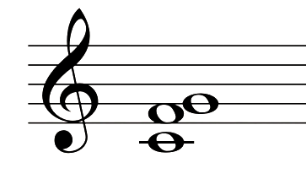
Sus4
1-4-5 | C-F-G

Slide 33
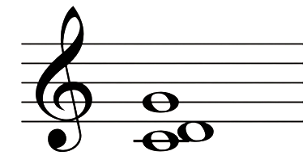
Sus2
1-2-5 | C-D-G

Slide 34
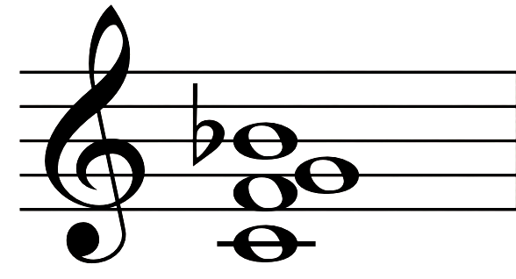
7Sus4
1-4-5-b7 | C-F-G-Bb

Slide 35
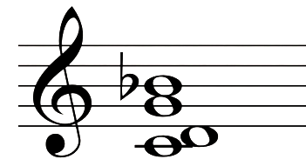
7Sus2
1-2-5-b7 | C-D-G-Bb

Slide 36
ทำแบบฝึกหัด

Slide 37
Inversion Chord

Slide 38
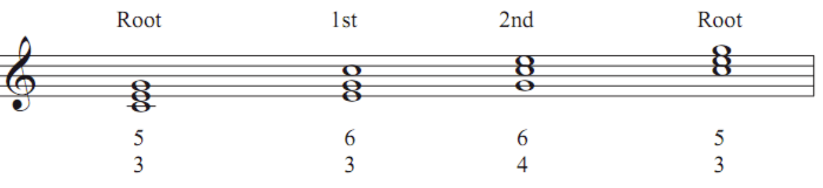
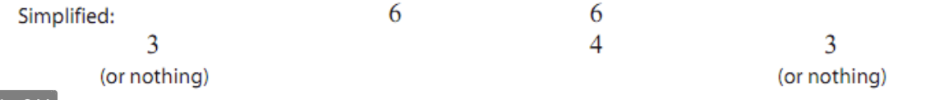
Triads

Slide 39
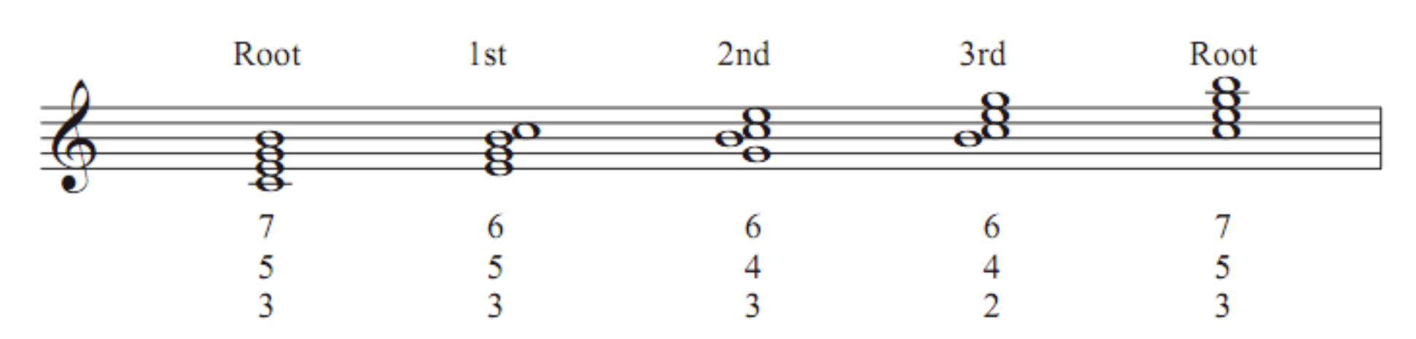
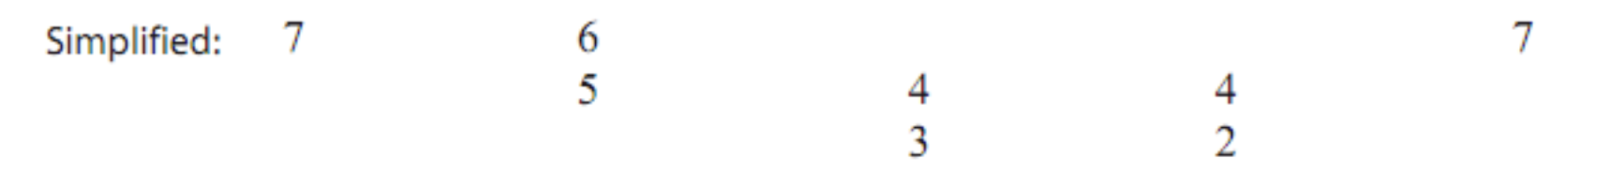
Dominant Seventh Chord Inversions

