Slide 1
Meme guidelines

Slide 2
The first memetic book was written by Richard Dawkins

Slide 3
The term meme (from the Greek mimema, meaning “imitated”) was introduced in 1976 by British evolutionary biologist Richard Dawkins in his work The Selfish Gene.

Slide 4
"meme" has been roots word from the Greek language.
Mimetismos + Gene = การแพร่การจายถ่ายทอดด้วยวิธีเลียนแบบ

Slide 5
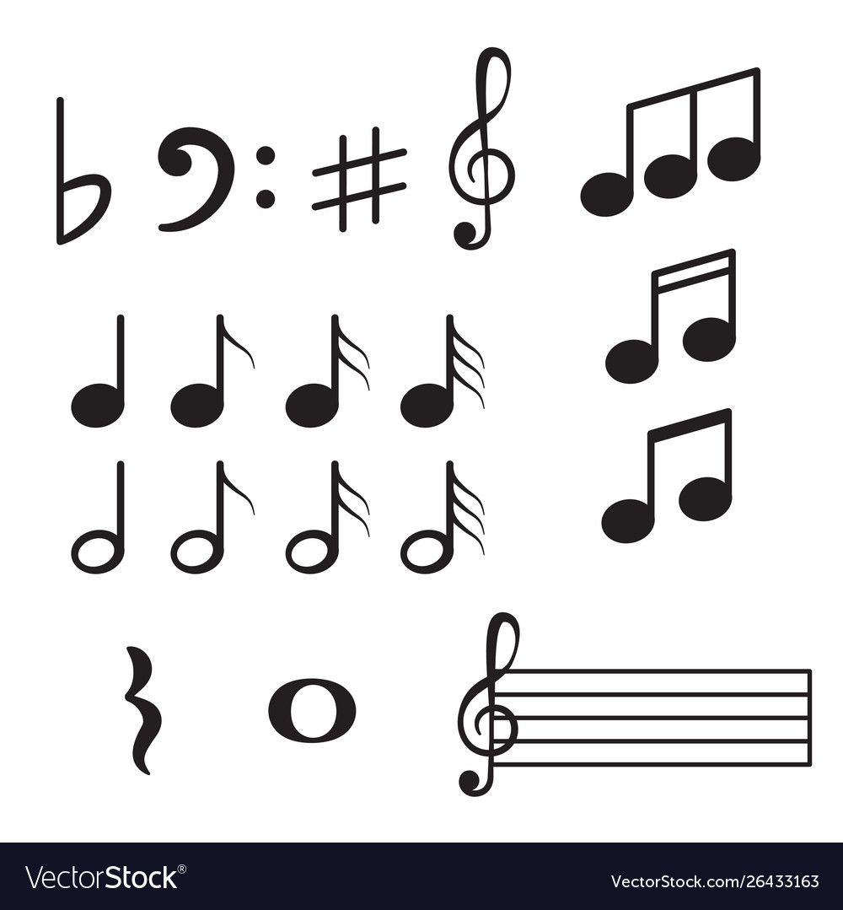
melody

Slide 6
catchphrase

Slide 8
fashion

Slide 9
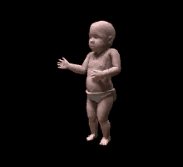
Baby dancing cha-cha-cha

Slide 10
Gavin Thomas

Slide 11
Gavin Thomas

Slide 12
Gavin Thomas

Slide 13
Gavin Thomas

Slide 14
Gavin Thomas

Slide 15
Gavin Thomas

Slide 16
oshita Iheme

Slide 17
oshita Iheme

Slide 18
oshita Iheme

Slide 19
oshita Iheme

Slide 20
oshita Iheme

Slide 21
Disaster girl by Zoe Roth

Slide 22
The cat forced a smile

Slide 29
swarming cat

Slide 32
Doge

Slide 33
Foever alone

Slide 34
me gusta

Slide 35
y u no guy

Slide 36
nyan cat

Slide 37
neil degrasse tyson reaction

Slide 38
overly attached girlfriend

Slide 39
Drake

