Slide 1
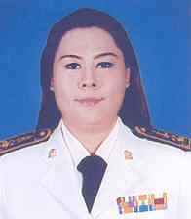
Formal Thai National Costume in the reign of King Bhumibol Adulyadej.
Chanoknart Mayusoh
Suan Sunandha Rajabhat University, Thailand

Slide 2
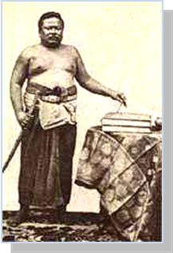
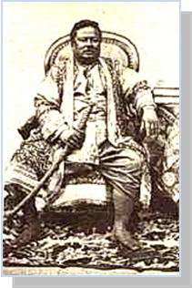
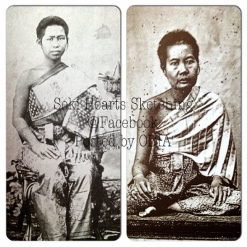
INTRODUCTION
Men costume in the reign of King Rama I-II
Women costume in the reign of King Rama I-II

Slide 3
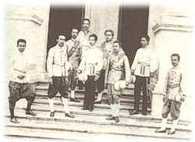
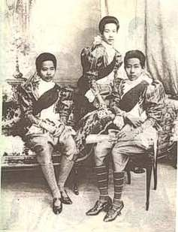
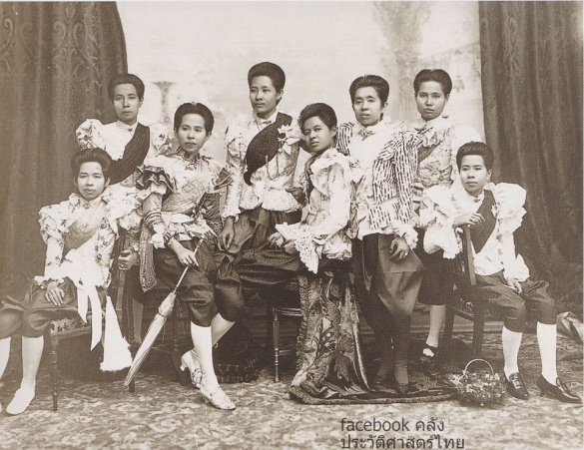
INTRODUCTION
The Uniform in the reign of King Rama IV
The costumes Her Majesty the Queen and princess the reign of King Rama IV

Slide 4
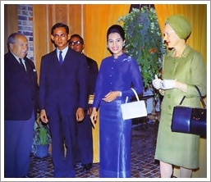
INTRODUCTION
The visiting of King and Queen at Europe and America in 1960’s

Slide 5
Objectives of the Research
To study history of formal Thai national costume for women and men in the reign of King Rama IX.
To study on deigns, materials, occasions, and dressmaking of formal Thai national costume for women and men in the reign of King Rama IX.

Slide 6
Research Methodology
This research is qualitative research and all data herein was obtained by the researcher with the following research procedures:
Study data obtained from related papers and research.
Study field data through observation and listening to comments of experts.
Analyze the obtained results.
Conclude the results and write a research report
Create 8 models of formal Thai national costume for women and 2 models of Thai traditional costume for men.

Slide 7
Result of the Research
8 designs of contemporary Thai costumes
A. Three designs of Pha Sin Pai costumes were consisted of:
Thai Ruean Ton, Thai Chit Lada, Thai Amarin
B. Five designs of Na Nang costume including of :
Thai Borom Phiman, Thai Siwalia, Thai Chakkri, Thai Dusit,
and Thai Chakkraphat
C. Three designs of Thai traditional costume for men including:
short-sleeve shirt, long-sleeve shirt, and shirt with long-sleeve
shirt with breechcloth

Slide 8
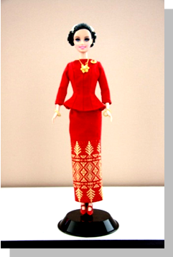
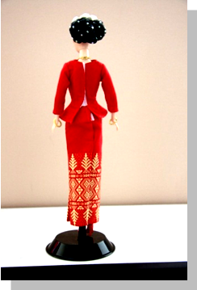
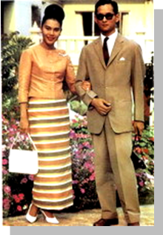
Thai Ruean Ton
Thai Ruean Ton costume with round scooped neckline blouse contained with five buttonholes cut and ¾ sleeves match with fabric strip in the frontage

Slide 9
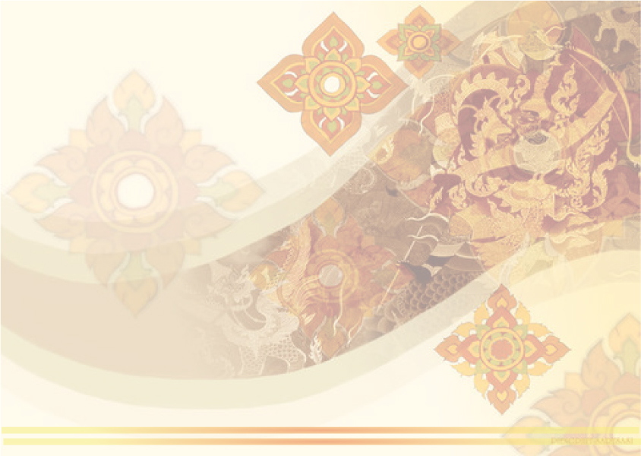
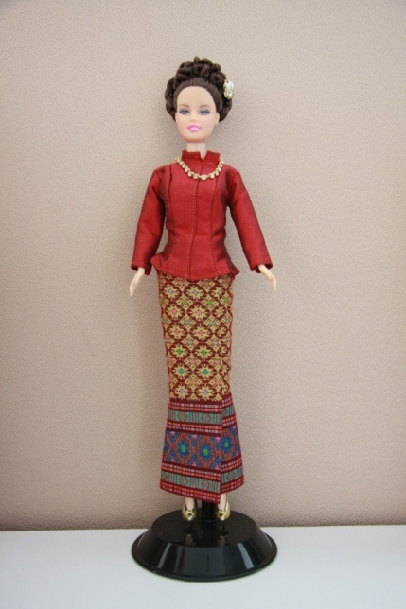
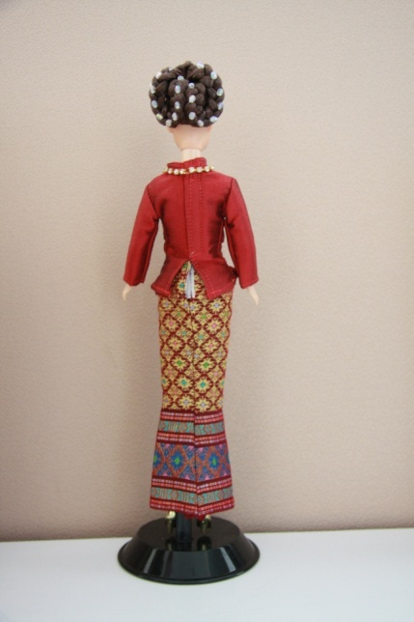
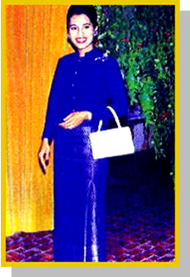
Thai Chit Lada
Thai Chit Lada costume with round neck blouse and collar contained with five buttonholes cut and long sleeves to the wrist match with fabric strip in the frontage

Slide 10
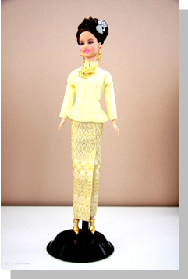
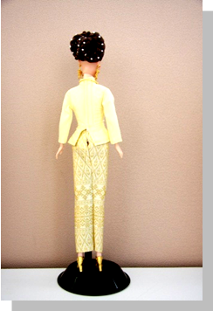
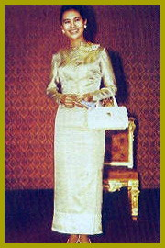
Thai Amarin
Thai Amarin costume had similar appearance with Thai Chitralada costume but it was made from Learn silk and brocaded with gold lace match with fabric strip in the frontage.

Slide 11
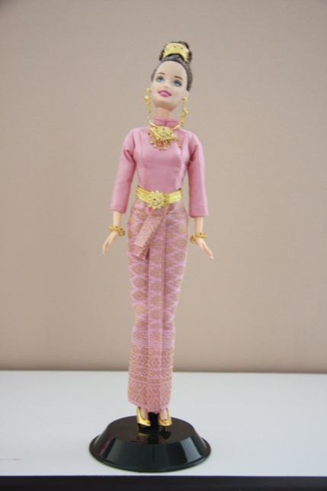
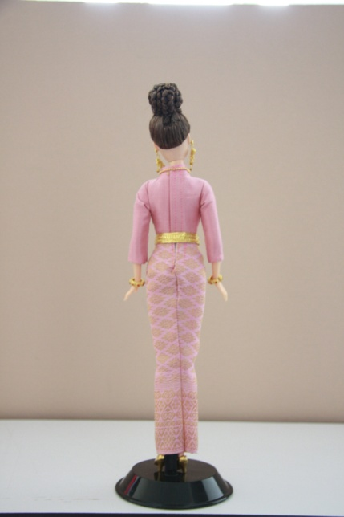
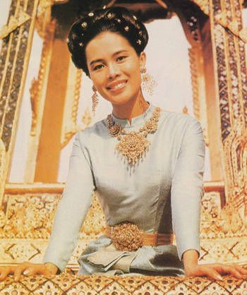
Thai Boromphiman
Thai Boromphiman costume withround neck blouse and collar contained with zip behind its long sleeves to the wrist match with thin fabric gathered in folds and two ends of it fabric were twisted together and tucked up in the front.

Slide 12
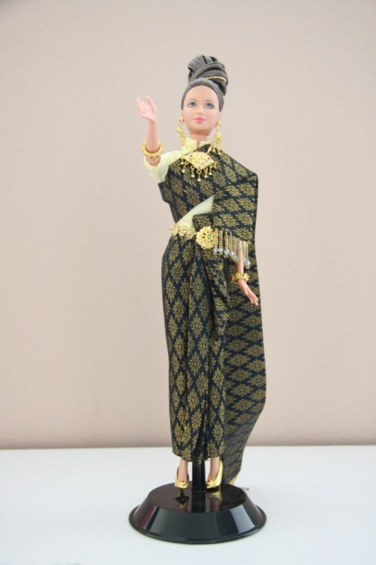
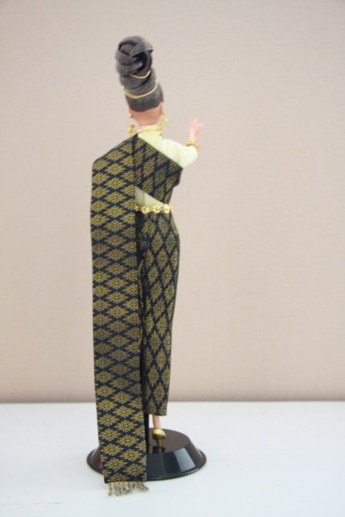
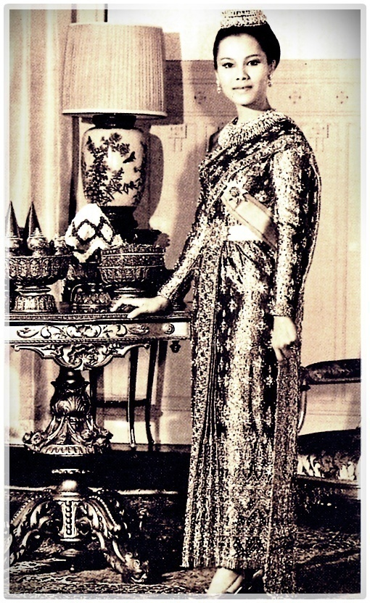
Thai Siwalai
Thai Siwalai costume had similar design with Thai Boromphiman costume but contained with breast cloth without silk fabric gathered in folds match withthin fabric gathered in folds and two ends of it fabric were twisted together and tucked up in the front.

Slide 13
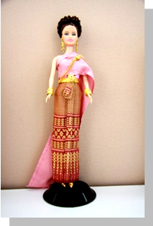
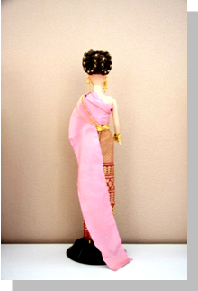
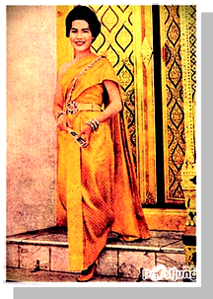
Thai Chakkri
Thai Chakri costume with off-shoulder blouse covered with breast cloth match with thin fabric gathered in folds and two ends of it fabric were twisted together and tucked up in the front.

Slide 14
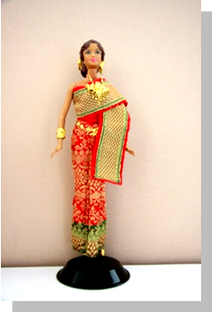
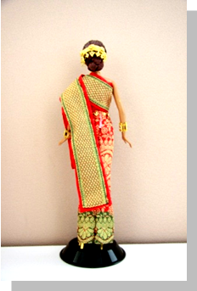
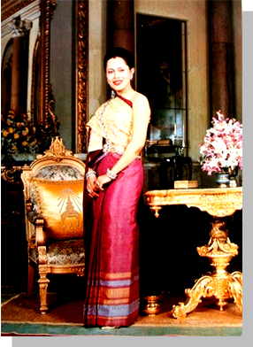
Thai Chakkraphat
Thai Chakkraphat costume consisted of 2 designs: one was similar to Thai Chakri costume and Thai Siwalai costume but covered with 2 layers of breast cloth, i.e., the first layer was silk fabric gathered in folds and covered with Krong Thong breast cloth or embroidered breast cloth with one of its end was left at the waist level and another one was surrounded under wearer’s right arm for leaving its end at the back side match with thin fabric gathered in folds and two ends of it fabric were twisted together and tucked up in the front.

Slide 15
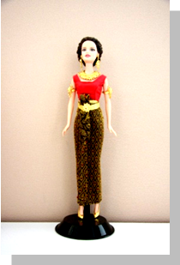
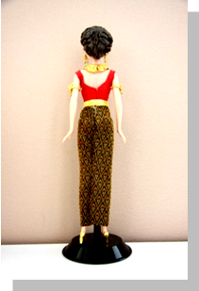
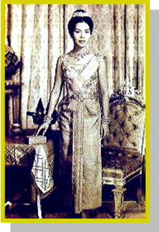
Thai Dusit
Thai Dusit costume with sleeveless, backless and wide neck blouse with zip at the back and decorated with pearl or sequin match with thin fabric gathered in folds and two ends of it fabric were twisted together and tucked up in the front.

Slide 16
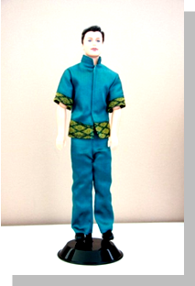
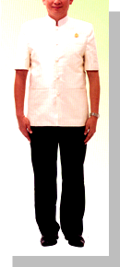
short-sleeve shirt
short-sleeve shirt made of cotton fabric for casual wear.

Slide 17
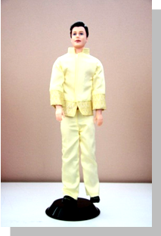
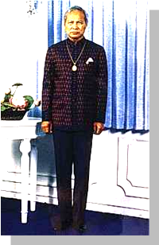
long-sleeve shirt
long-sleeve shirt made of silk for special occasion.

